Slide 1
PubMed and other databases:
Repertory of scientific knowledge in homeopathy
Daniela Hacke – Witten/Herdecke University
Christa Raak – Witten/Herdecke University
Subcommittee Documentation – 2020

Slide 2
Objectives
Introduction to the most important databases
Methodology of searching for clinical trials
Special features of PubMed
Creating a search strategy (in PubMed)
Concrete example for a search strategy by means of a systematic review
Subcommittee Documentation – 2020

Slide 3
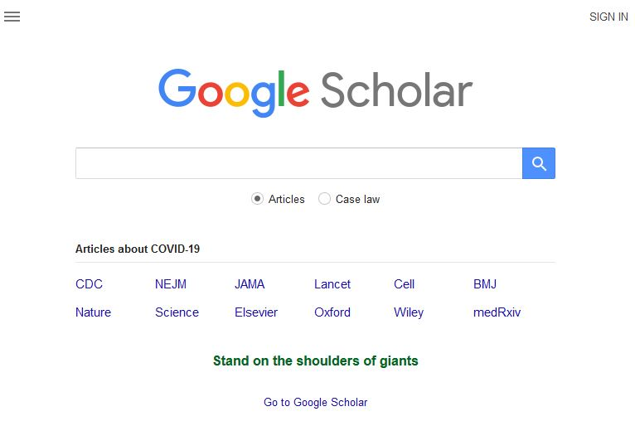
Google Scholar
https://scholar.google.com
Subcommittee Documentation – 2020

Slide 4
Google Scholar – facts and figures
No database but an online search engine for scholarly literature
Basic and advanced search options
Links to related citations, authors and publications
Advantages: searches in papers, theses, books, preprints, abstracts and reports, many fulltexts free of costs
Disadvantages: restricted search and sorting options, no controlled search vocabulary (like MeSH)
Subcommittee Documentation – 2020

Slide 5
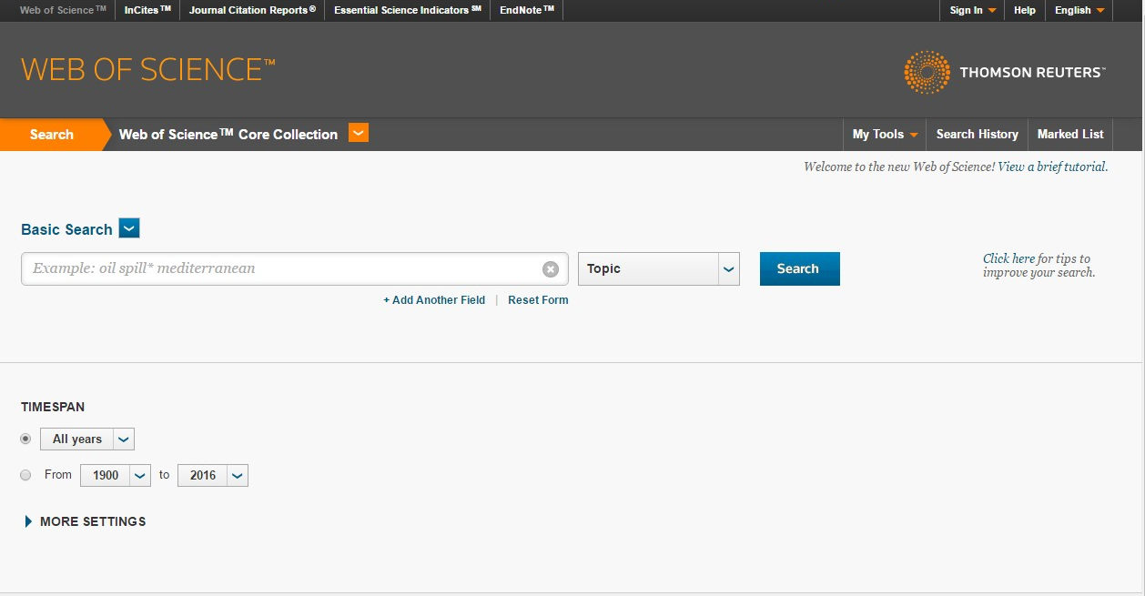
Science Citation Index Expanded
Subcommittee Documentation – 2020

Slide 6
Science Citation Index Expanded
– facts and figures
Access only by institutional registration via Web of Science ™ (Doctors associations or university)
Scientific literature from more than 9,200 major journals across 178 disciplines of medicine, life sciences and (bio)technology
About 53 mill. records and 1,18 billion cited references (from 1900 to present)
Abstracts for approx. 70 % of the articles (1991 to present)
Special feature: cited references search, enabling to track prior research articles
Important for researchers, less for doctors
Subcommittee Documentation – 2020

Slide 7
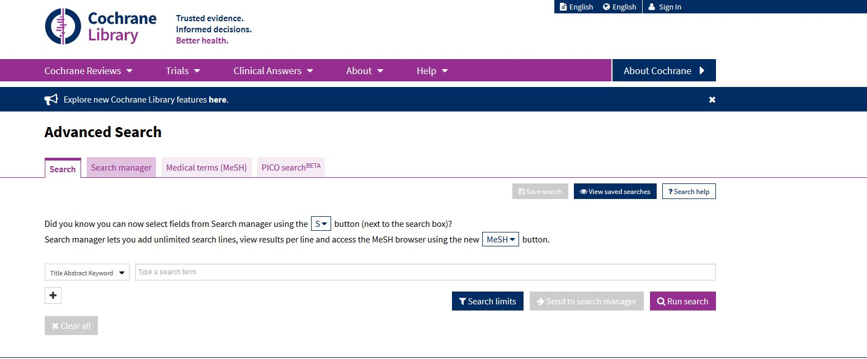
Cochrane library
http://www.cochranelibrary.com/
Subcommittee Documentation – 2020

Slide 8
Cochrane library – facts and figures
Collection of three databases:
  Cochrane Database of Systematic Reviews (CDSR) – ca. 9,500 records (new: 8,279 records)
  Cochrane Central Register of Contr. Trials (CENTRAL) – ca. 965,000 records (new: 1,615,467 records)
  Cochrane Clinical Answers (CCAs) – ca. 2367 records, simply structures entry point for clinical decision-making
Important source for peer-reviewed systematic reviews and (quasi-) randomised controlled trials
Search for bibliograph. data and abstracts and full texts: free of costs
Subcommittee Documentation – 2020

Slide 9

ScienceDirect
http://www.sciencedirect.com
Subcommittee Documentation – 2020

Slide 10
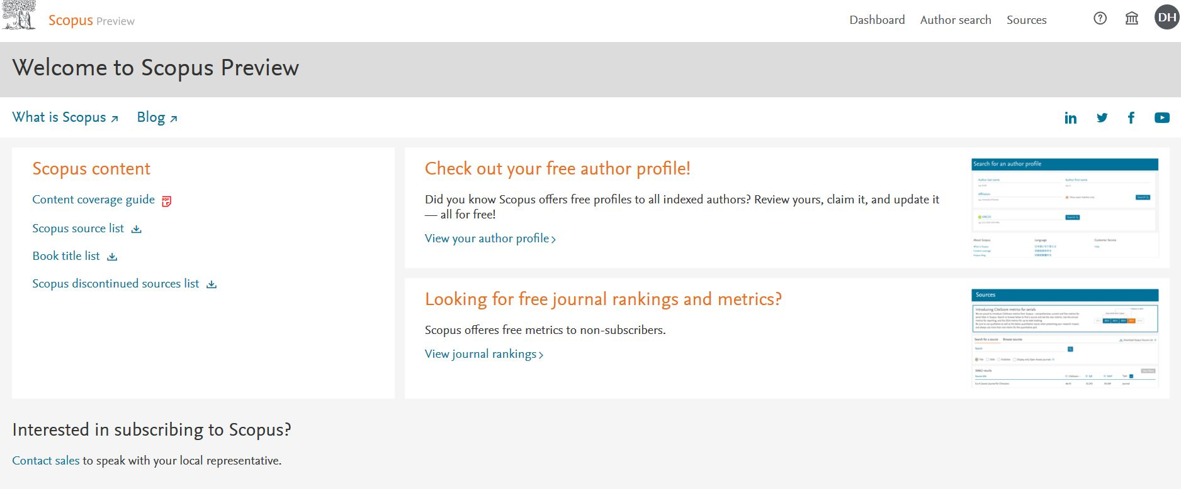
Scopus
https://www.scopus.com
Subcommittee Documentation – 2020

Slide 11
ScienceDirect/Scopus – facts and figures
ScienceDirect: provided by Elsevier Science since 1997
- about 16 mill. full text articles from over 2,500 journals from several publishers from 1995 to present
- search for bibliograph. data/abstracts is free of costs, access to most of the fulltexts only via subscription
Scopus: provided by Elsevier Science since 2004
- accessible only via institutional subscription
- abstracts and bibliograph. data from about 78 mill. articles from more than 23,452 peer-reviewed journals plus proceedings, books and patents
- cross-references between articles
Both: possibility to create search alerts, many entries on homeopathy and CAM
Subcommittee Documentation – 2020

Slide 12
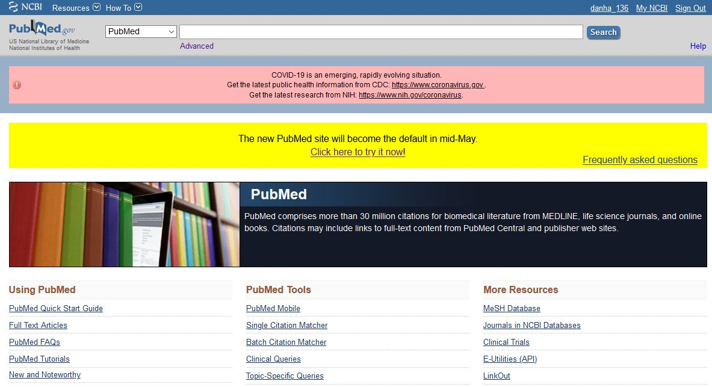
PubMed
https://www.ncbi.nlm.nih.gov/pubmed
Subcommittee Documentation – 2020

Slide 13
PubMed – search features
Subset filters (e.g. Subject: „Complementary medicine“, Species: „Human“ etc.)
Search limits (e.g. „Clinical queries“)
MeSH Thesaurus terms (MeSH = Medical Subject Headings)
Boolean operators („AND“, „OR“, „NOT“)
Subcommittee Documentation – 2020

Slide 14
PubMed – helpful tools
Search history
Saving of search history, creating of e-mail alerts/RSS-feeds after registration (My NCBI profile)
Display settings (e.g. order of results etc.)
Export modalities
Subcommittee Documentation – 2020

Slide 15
PubMed – How to search
PICO model – Precision of search questions
Clear definition of terms and synonyms
Consideration of different spelling (e.g. „homeopathy“ – „homoeopathy“)
Truncation or wildcard - examples:
homeopathy/homeopathic/homeopatia etc.
=> „homeopat*“
homeopathy/homoeopathy => „hom*pathy“
Free text search , advanced search and/or MeSH search
Subcommittee Documentation – 2020

Slide 16
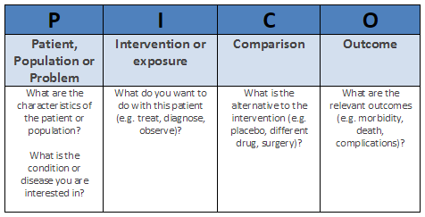
PICO model
Technique for framing and answering a clinical or health care related question
Subcommittee Documentation – 2020

Slide 17
PICO in practice
Example for framing a search question using the PICO model:
P – children with diarrhea
I – homeopathic treatment
C – placebo
O – amelioration of diarrhea symptoms
Subcommittee Documentation – 2020

Slide 18
Why search in different databases?
Results for the search terms „homeopath*“ OR „homoeopath*“ in PubMed, Cochrane Library, SCI Expanded, Google Scholar, ScienceDirect
Subcommittee Documentation – 2020

Slide 19
Example search strategy
“A systematic review and meta-analysis on the use
of Hypericum perforatum (St. John’s Wort) for
pain conditions in dental practice”
Christa Raak, Arndt Büssing, Georg Gassmann, Katja Boehm, Thomas Ostermann
Homeopathy (2012) 101, 204-210
Method:
PubMed, EMBASE, AMED, CAMbase and the electronic archives
of Thieme Publishers were searched with the search terms “(Hypericum OR St. Johns Wort) AND pain”. The evidence on Hypericum perforatum in pain after tooth extraction was carried out (Review and meta-analysis).
Subcommittee Documentation – 2020

Slide 20
Example search strategy
The following electronic databases were used to find articles:
PubMed
EMBASE,
AMED
CAMbase
“Zeitschrift für klassische Homöopathie” (electronic archive)
“Allgemeine Homöopthische Zeitung” (electronic archive)
Each database was searched from its inception until February 2010.
We applied two search strategies:
Subcommittee Documentation – 2020

Slide 21
Example search strategy
We collected relevant articles on basic research on Hypericum perforatum and pain related outcome. The search terms for pain related articles on
Hypericum perforatum were “(Hypericum OR St. Johns Wort) AND pain”
(including translations to German and French).
Articles in which the application of Hypericum in dental care was described in clinical studies, case reports or expert opinions were identified. To retrieve evidence on the use of H. perforatum in dental care the search terms were “(Hypericum OR St. Johns Wort) AND (dental OR dentistry)” and their translations to German and French.
Subcommittee Documentation – 2020

Slide 22
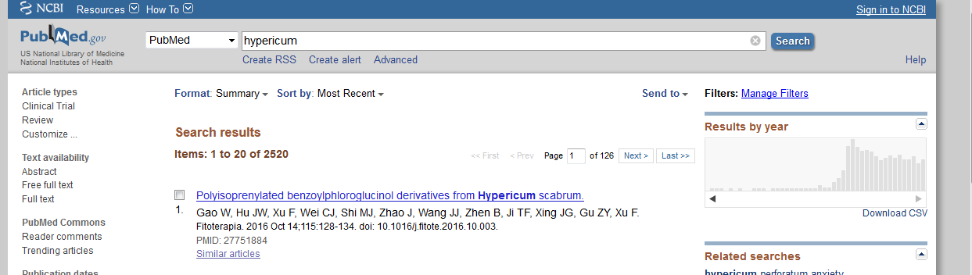
Example search strategy
First step: Search for “Hypericum”
Subcommittee Documentation – 2020

Slide 23
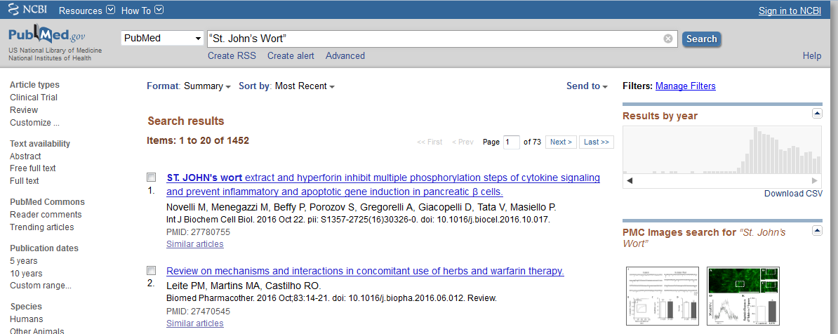
Example search strategy
Second step: Search for “St. John’s Wort”
Subcommittee Documentation – 2020

Slide 24
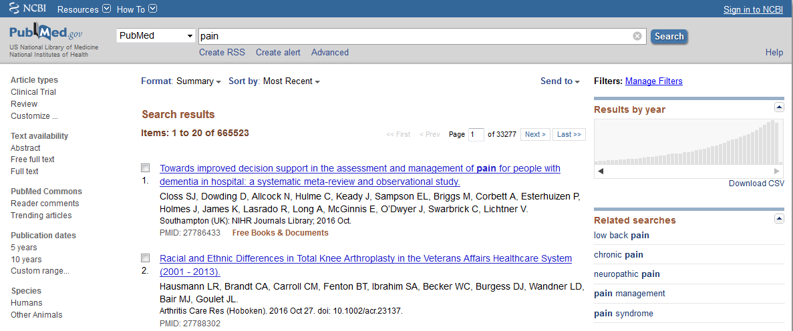
Example search strategy
Third step: Search for “pain”
Subcommittee Documentation – 2020

Slide 25
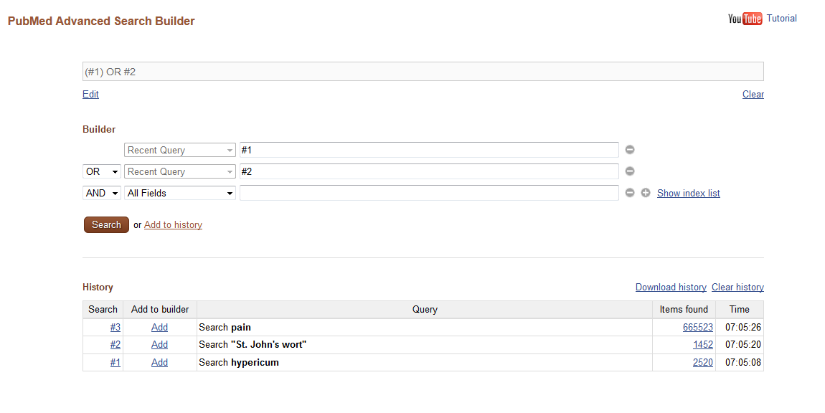
Example search strategy
Fourth step: Combination of Search 1 and 2 with “OR”
Subcommittee Documentation – 2020

Slide 26
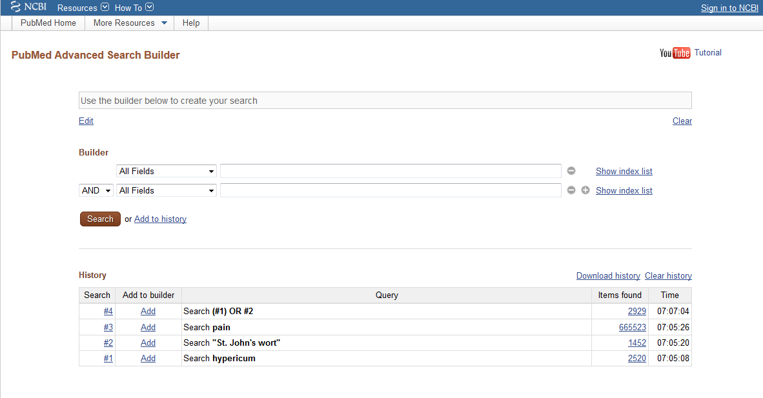
Example search strategy
Fourth step: Combination of Search 1 and 2 with “OR”
Subcommittee Documentation – 2020

Slide 27
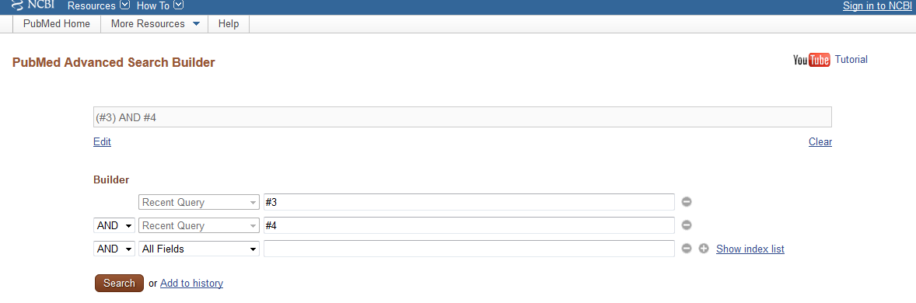
Example search strategy
Fifth step: Combination of Search 4 and Search 3 with “AND”
Subcommittee Documentation – 2020

Slide 28
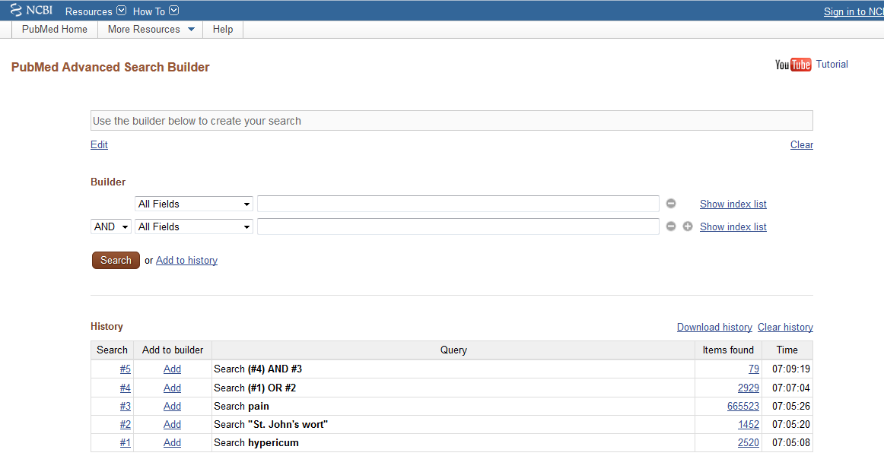
Example search strategy
Fifth step: Combination of Search 4 and Search 3 with “AND”
Subcommittee Documentation – 2020

Slide 29
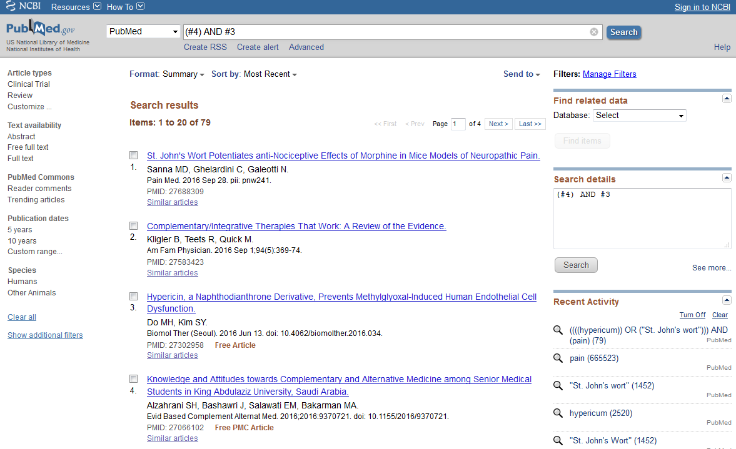
Example search strategy
Sixth step: Evaluate the results by abstract screening
Subcommittee Documentation – 2020

Slide 30
Example search strategy
Repertorisation and systematic literature search have
things in common:
Repertorisation Systematic literature search
Symptoms 1,2,… Search terms 1,2,…
Combination with
AND/OR
Remedies 1,2,… Articles 1,2,…
Full text screening
Conclusion
Subcommittee Documentation – 2020

Slide 31
Example search strategy
Conclusion
Working with the “Repertory of scientific knowledge in
homeopathy” can be done in different ways.
Pubmed search is free, comprehensive and offers a wealth of information.
Practitioners: quickly identify reliable sources by so-called "wild searching“ is a possible way to go.
Scientists: systematic search must be traceable step by step.
Subcommittee Documentation – 2020

Slide 32

Thank you !
Subcommittee Documentation – 2020

