Slide 1
Homeopathy in (Scientific) Databases:
Making The Most Of Your Literature Searches
ECH Documentation Subcommittee
ECH Congress Vienna
17 November 2016

Slide 2
Homeopathy in (Scientific) Databases:
How to Improve At
Literature Searching
In 60 Minutes
ECH Documentation Subcommittee
ECH Congress Vienna
17 November 2016

Slide 3
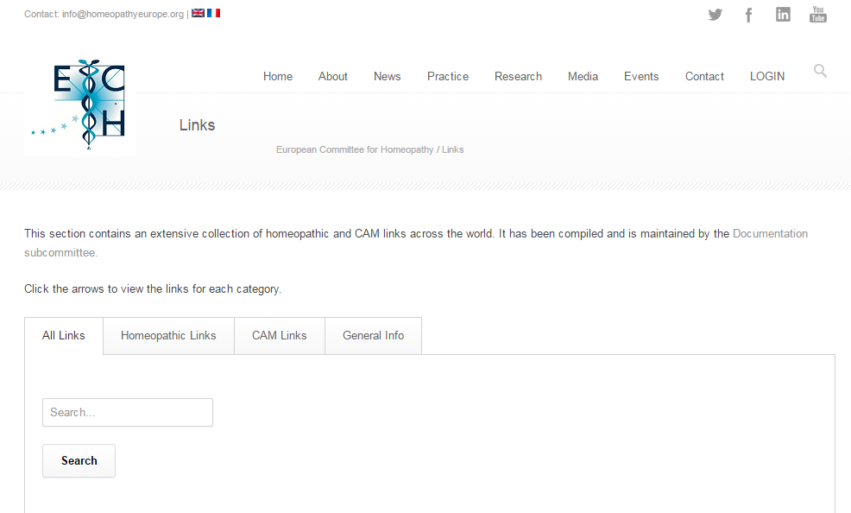
ECH Links
ECH Subcommittee Documentation
Database with
275 links
Three main categories:
- Homeopathy
- CAM
- General info
Subcategories:
- Homeopathy: 15
- CAM: 8
- General info: 4
Notes:
Life presentation of the linklist

Slide 4
Major Information Resources in Homeopathy
Homeopathy databases
Library catalogues
Clinical cases
CAM databases
Open access journals

Slide 5
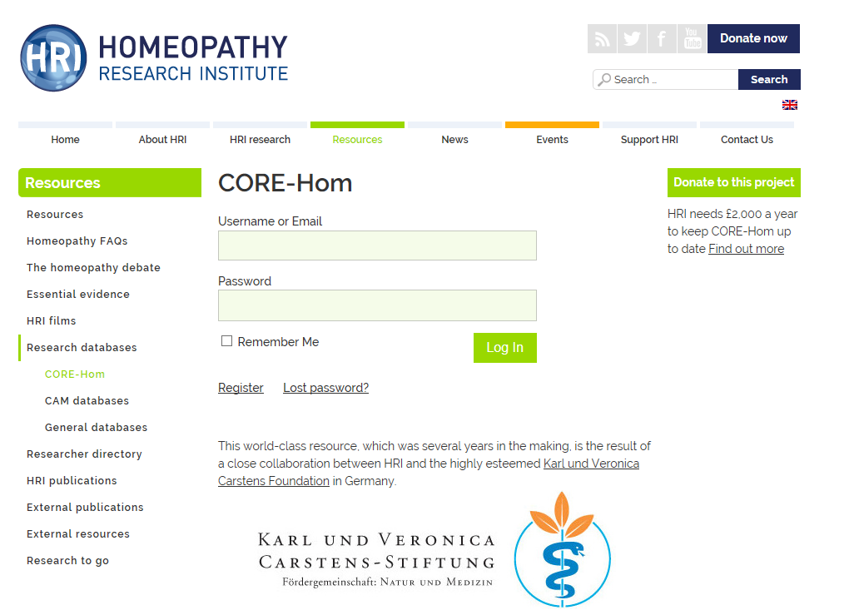
Homeopathy databases
CORE-Hom
Carstens Foundation
&
Homeopathy Research Institute
Literature references on
clinical outcome research
1,120 clinical trials
With study details
Notes:
Free database, access via registration.

Slide 6
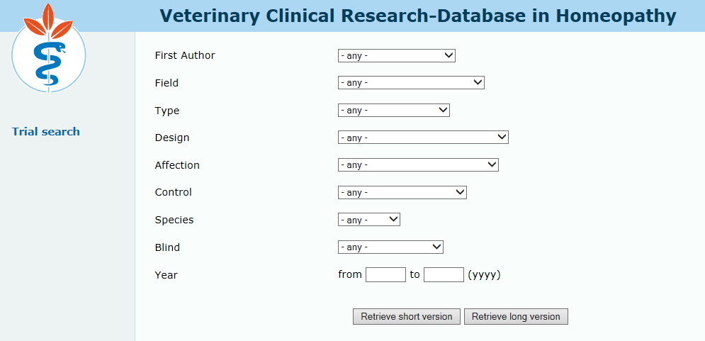
Homeopathy databases
Veterinary Clinical Research-Database in Homeopathy
Carstens Foundation
Literature references on
veterinary research in homeopathy
With study details
444 clinical trials and cases
Notes:
Free database, access without registration.

Slide 7
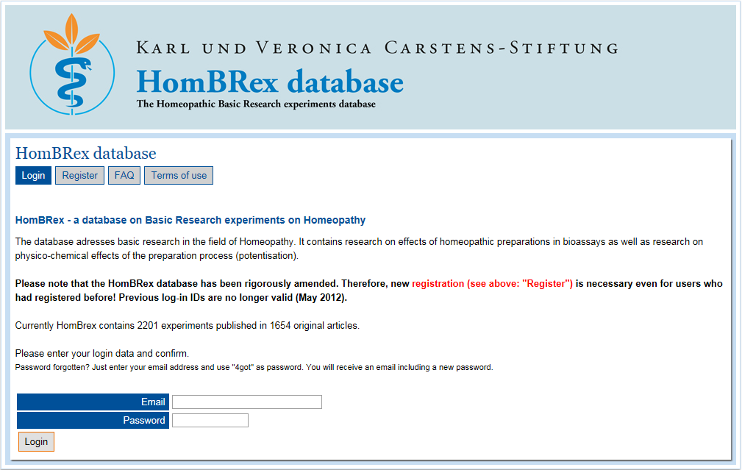
Homeopathy databases
The Homeopathic Basic Research Experiments Database
Carstens Foundation
Literature references
With study details
Currently 2,216 experiments published in 1,661 original articles
Notes:
Free database, access via registration.

Slide 8
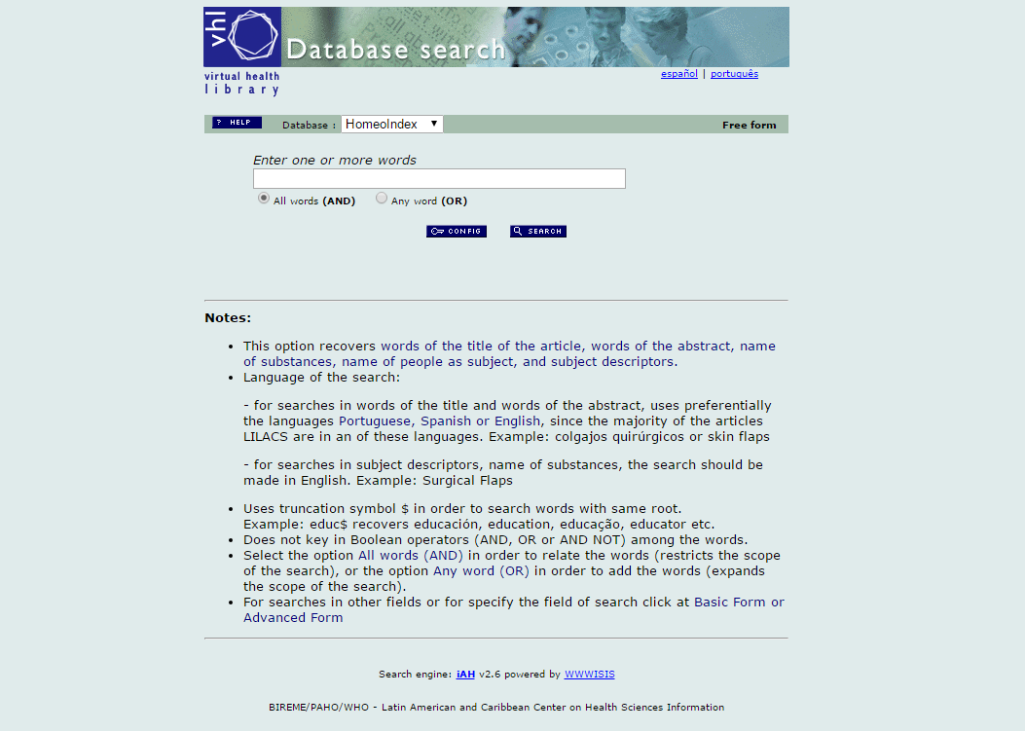
Homeopathy databases
HomeoIndex
Literature references
No study details
About 9,400 hits for homeopathy in all fields
Notes:
Free database, access without registration.

Slide 9
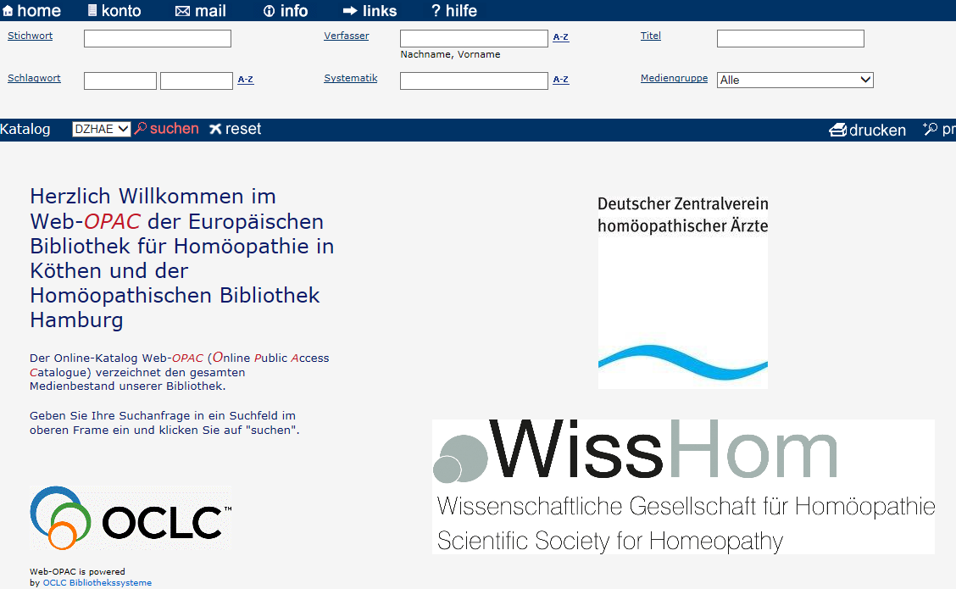
Library catalogues
DZVhÄ Homeopathic Libraries
In German
Books catalogue
About 4,000 books
Notes:
https://hombib-opac.internetopac.de/index.asp?DB=151258

Slide 10
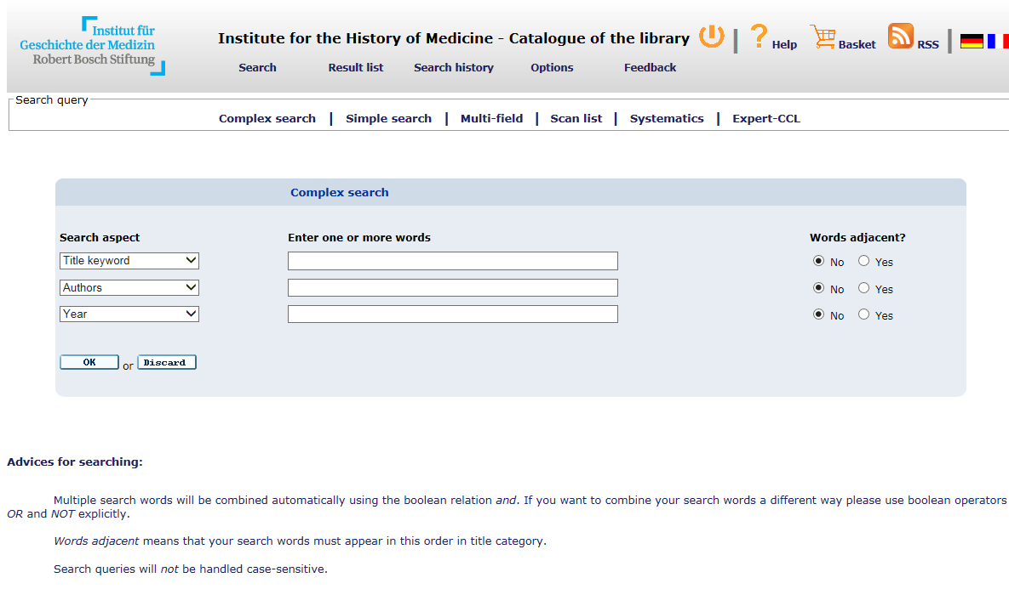
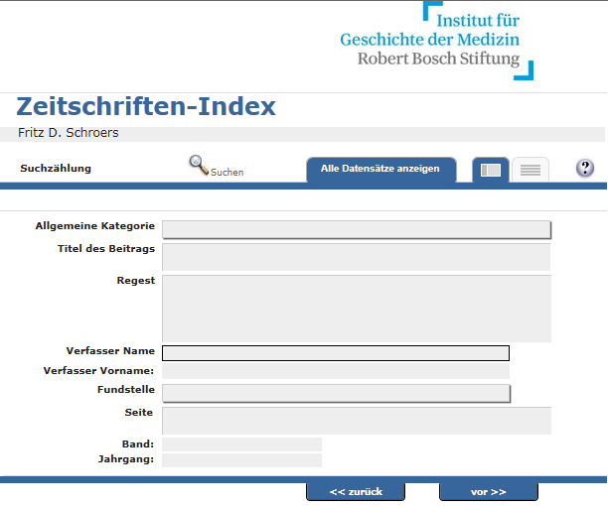
Library catalogues
Institute for the History of Medicine of the Robert Bosch Foundation
(Stuttgart)
History of medicine
Catalogue with 11,400 volumes on homeopathy
Separate database with a selection of indexed journals
Of which ca. 4,000 journal volumes
Notes:
Free database, access without registration.

Slide 11
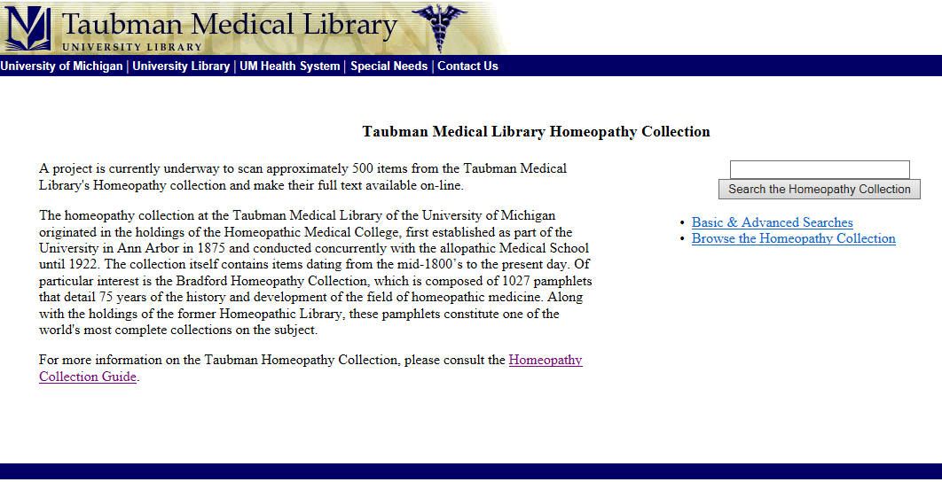
Library catalogues
Taubman Medical Library Homeopathy Collection
University of Michigan
Homeopathy
Mainly English books
Scans of 500 volumes planned

Slide 12
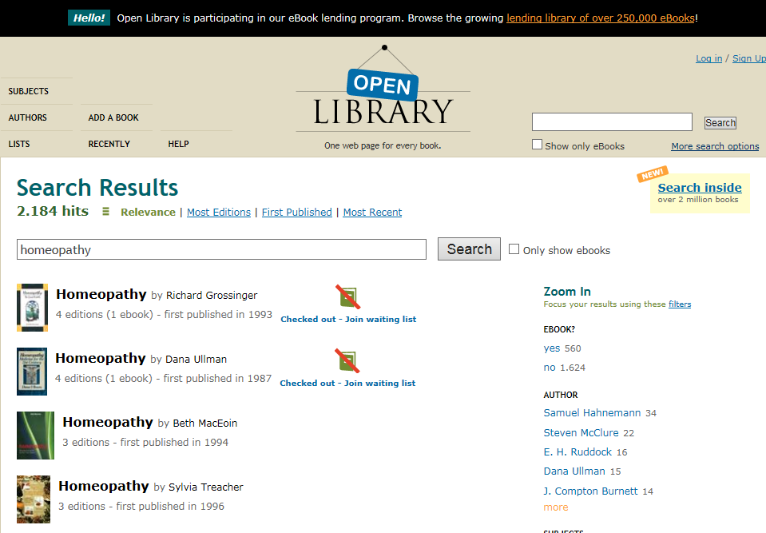
Full Text Documents
Open Library
Open catalogue of e-books
(scanned versions or links to external sources)
>2,000 volumes on homeopathy availabile
Partially free to read online
Books can be borrowed by Open Library account holders
Notes:
https://openlibrary.org/

Slide 13
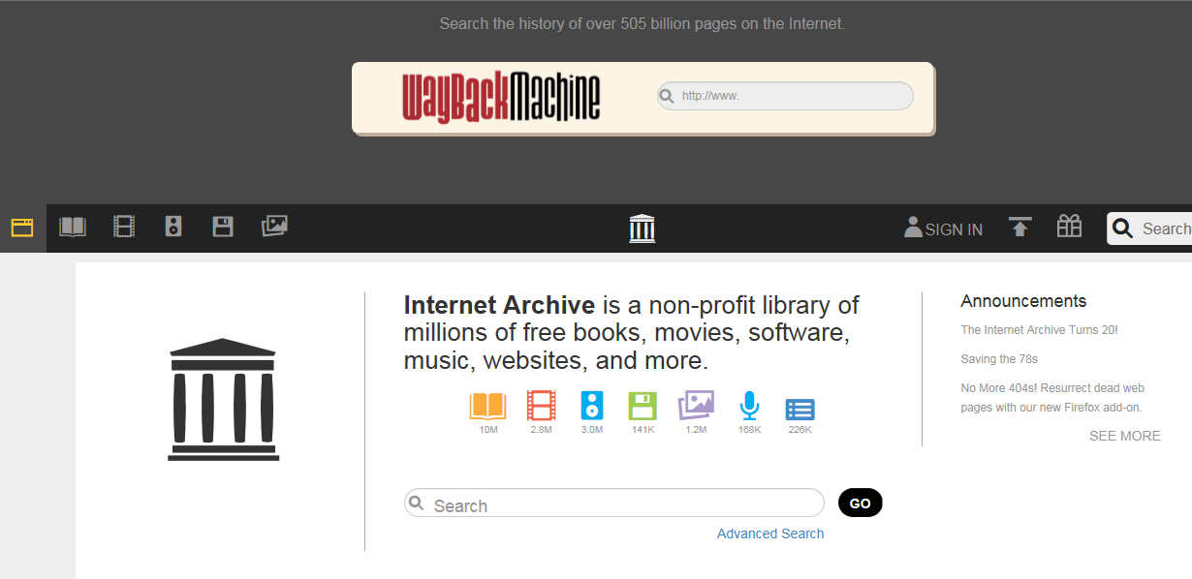
Full Text Documents
Internet Archive
Free e-books and other electronically available media
> 2,000 hits for homeopathy
Notes:
https://archive.org/
Free database, access via registration.

Slide 14
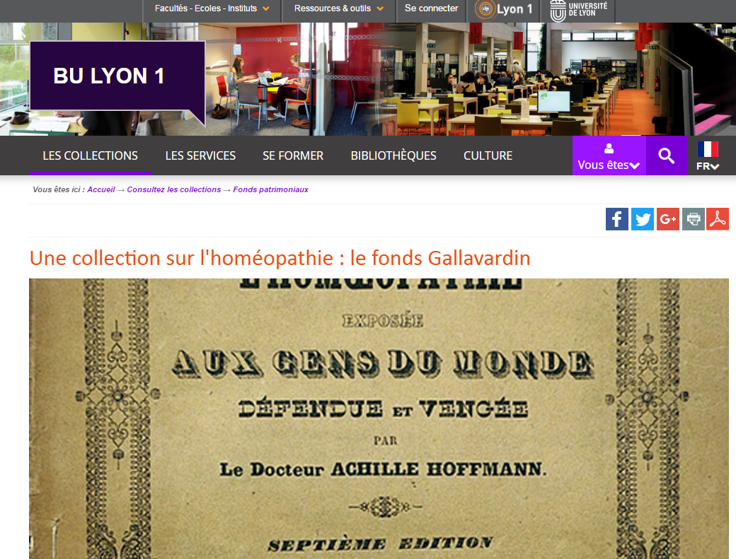
Full Text Documents
Le fonds Gallavardin
Collection of Dr Jean-Pierre Gallavardin (1825-1898)
800 titles on homeopathy available via the catalogue of the University of Lyon
In French

Slide 15
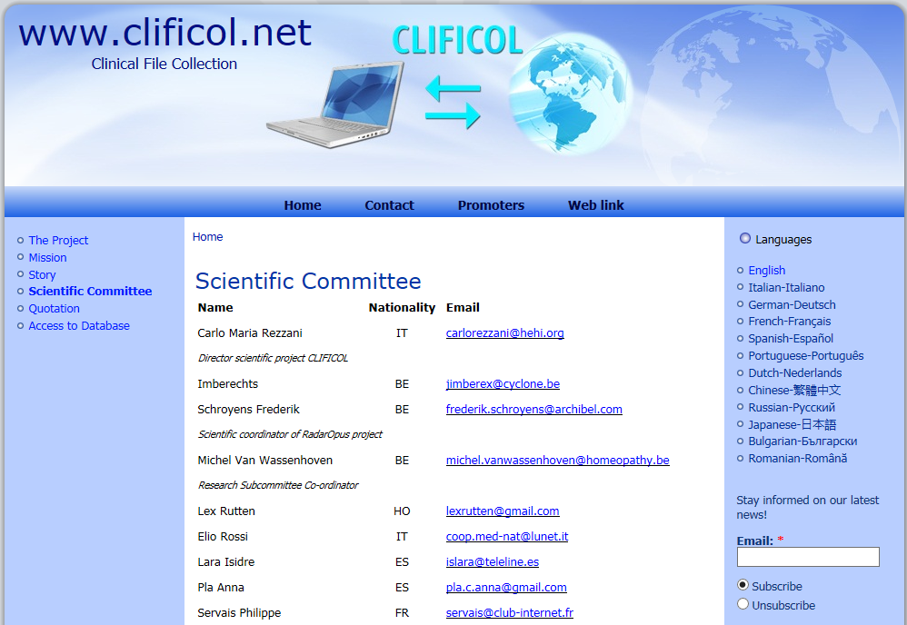
Cases
Clificol
Initiated by Homeopathia
Europea & Internationalis
Groups in the 1970s
Database of cases
International project
Free of charge
Registration necessary
Notes:
Empirium publications:
R. Schäferkordt, C. Kösters: Das WissHom-Projekt "Empirium". AHZ 2015; 260(03): 9-12
R. Schäferkordt, S. Hoffmann: Umfrage zum Thema Falldokumentation. AHZ 2014; 259(04): 14-20
R. Schäferkordt: Klinische Verifikation der Materia medica unter Anwendung des Bayes'schen Theorems. AHZ 2014; 259(03): 24-28

Slide 16
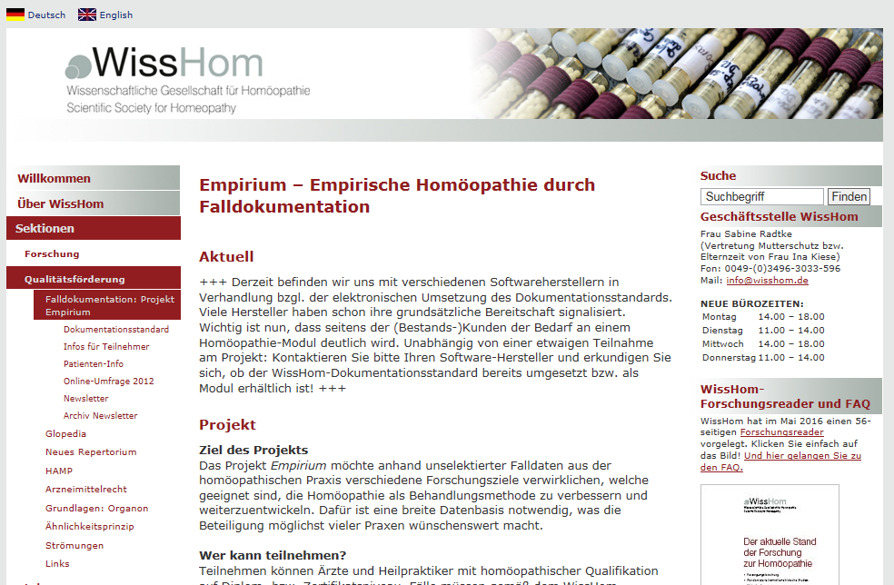
Cases
Empirium
WissHom project & documentation standard
Documentation system for cases in German
Coordinated by Rainer Schäferkordt
Notes:
Empirium publications:
R. Schäferkordt, C. Kösters: Das WissHom-Projekt "Empirium". AHZ 2015; 260(03): 9-12
R. Schäferkordt, S. Hoffmann: Umfrage zum Thema Falldokumentation. AHZ 2014; 259(04): 14-20
R. Schäferkordt: Klinische Verifikation der Materia medica unter Anwendung des Bayes'schen Theorems. AHZ 2014; 259(03): 24-28

Slide 17
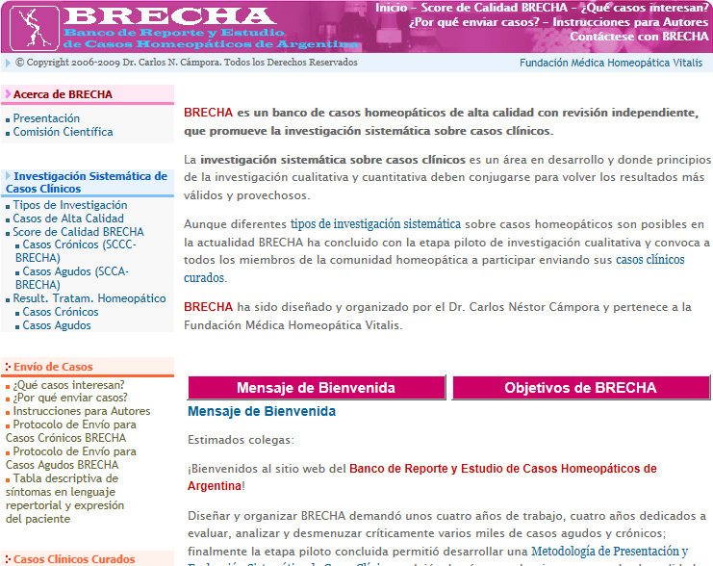
Cases
BRECHA
Banco de Reporte y Estudio
de Casos Homeopáticos de Argentina
Research database
Dr
Carlos N. Cámpora
Collection of cases of chronic diseases
Collection of cases of acute diseases
In Spanish
Notes:
Evidenz basierte Homöopathie
Carlos N. Cámpora
Evidenzbasierte Homöopathie (EBH) ist ein auf die Homöopathie zugeschnittenes Verfahren, das homöopathische Symptome, aber auch Methoden der Homöopathie auf der Grundlage der klinischen Verifikation bestätigt oder verwirft. Die Forschungsdatenbank für homöopathische Fall­darstellungen in Argentinien, BRECHA, ist in dieser Hinsicht wegweisend. Sie stellt sehr strenge Anforderungen an die Dokumentation und Bewertung der Behandlungsergebnisse. Diese Anforderungen erlauben eine Forschung anhand qualitativ hochwertiger Fälle, die qualitative und quantitative Elemente verbindet.
Hierfür wird eine spezielle Bewertungsskala für chronische und akute Fälle verwendet, die von Dr. Cámpora im Jahre 2001 entwickelt wurde. Diese Skala erlaubt eine numerische Bewertung, die Informationen über Qualität, Schwere und andere relevante Aspekte eines Falles liefert. Der Vortrag zeigt, dass hochwertige Falldarstellungen heute eines der wichtigsten Forschungsinstrumente zur Verbesserung der Qualität homöopathischer Verschreibungen sind.
http://www.google.de/imgres?q=Dr.+Carlos+N.+C%C3%A1mpora&hl=de&tbo=d&biw=1155&bih=559&tbm=isch&tbnid=Ao8aB_rKm_x4vM:&imgrefurl=http://www.homeopathy-congress.com/referent-campora.html&docid=NAHD6XzRmFsSYM&imgurl=http://www.homeopathy-congress.com/img/spk_campo_50.jpg&w=50&h=50&ei=ciS3UO3MGsbY4QTQm4G4CA&zoom=1&iact=hc&vpx=274&vpy=205&dur=1344&hovh=50&hovw=50&tx=107&ty=41&sig=115874591910470213571&page=1&tbnh=50&tbnw=50&start=0&ndsp=25&ved=1t:429,r:2,s:0,i:90

Slide 18
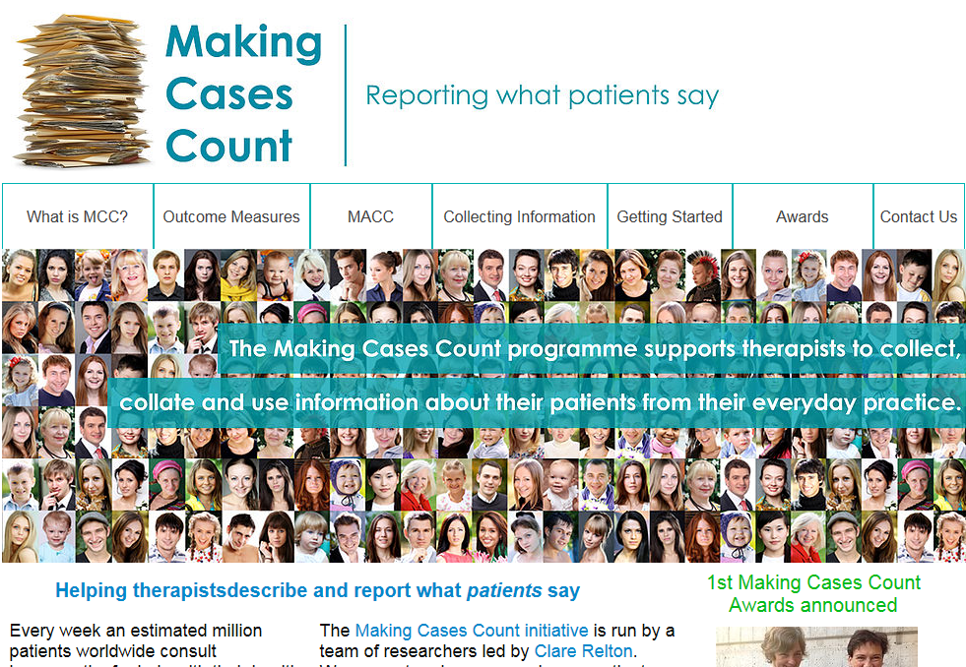
Cases
MCC - Making Cases Count
International project for documentation of cases in everyday practice
Structured documentation of cases from the perspective of patients
Chair: Clare Relton, University of Sheffield (UK)
Who consults homeopaths?
Why do they consult homeopaths?
What types of symptoms/ concerns/ problems do these patients have?
What happens to these patients - do they get better, worse or stay the same?
Notes:
References:
Relton, C., Viksveen, P., Kessler, U.
The Making Cases Count initiative.
Complementary therapies in medicine 2014; 22 (4): 621-624.
http://media.wix.com/ugd/54a892_89fdd4fbdc16489cbb2ca8aa76ca9a93.pdf
Kessler, U., Schäferkordt, R.
Viele Tropfen ergeben einen Ozean: wissenschaftliche Falldokumentation in der Homöopathie
Homöopathie Konkret 2012; 5 (3): 95-98.
Relton, C.
Untangeling the debate…
Powerpoint Präsentation. S. 35ff.

Slide 19
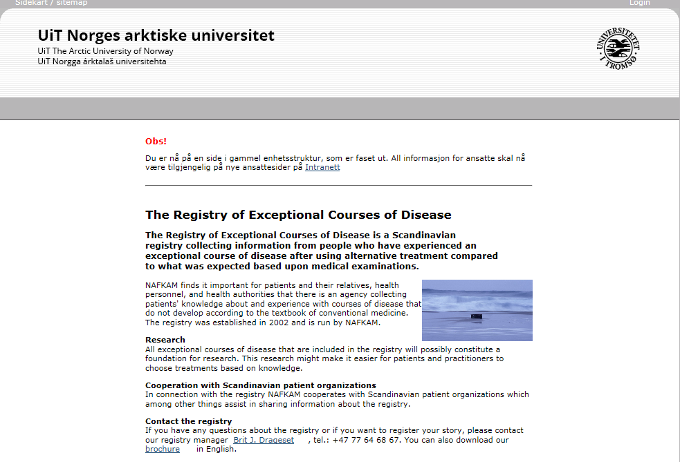
Cases
Registry of Exceptional Courses of Disease
National Research Center in Complementary and Alternative Medicine (NAFKAM), University of Tromsø (Norway)
Collection of extraordinary positive or negative CAM cases
Reporting of patients only
Not available to the public
Registry manager: Brit J. Drageset

Slide 20
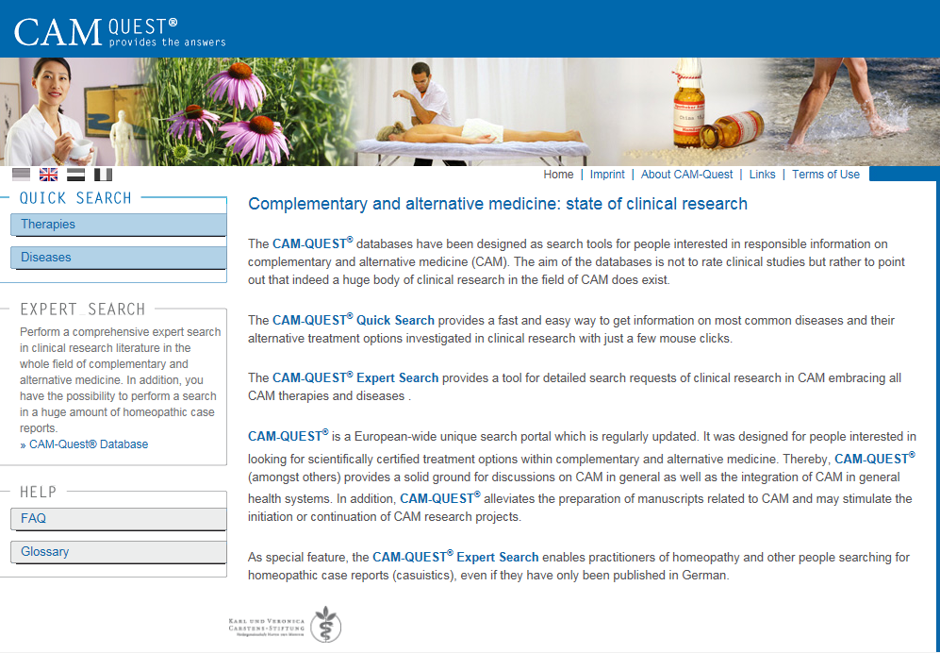
CAM databases
Clinical trials, systematic
reviews, meta-analyses, cases, provings etc.
More details
in poster presentation
Carstens Foundation
About 93,000 literature references
CAM-Quest
Notes:
http://www.cam-quest.org/en/
A search (no registration required) provides a reference list, actual documents can be requested from the Carstens Foundation.

Slide 21
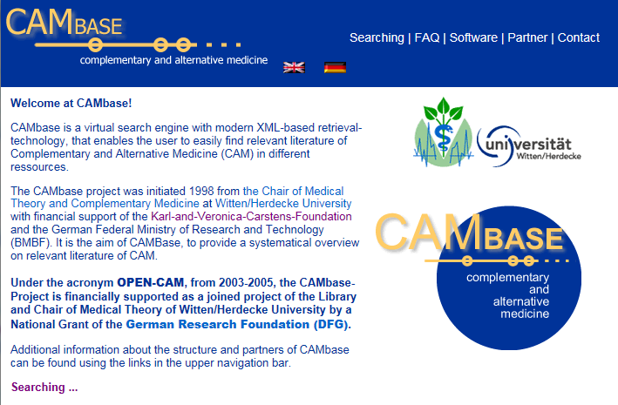
CAM databases
CAMBase
Witten/Herdecke University
Literature references / partially abstracts
Medline journals not included
Document delivery
Notes:
http://cambase.dmz.uni-wh.de/opencam/index_en.html
A search (no registration required) provides a reference list, actual documents can be requested from the university.

Slide 22
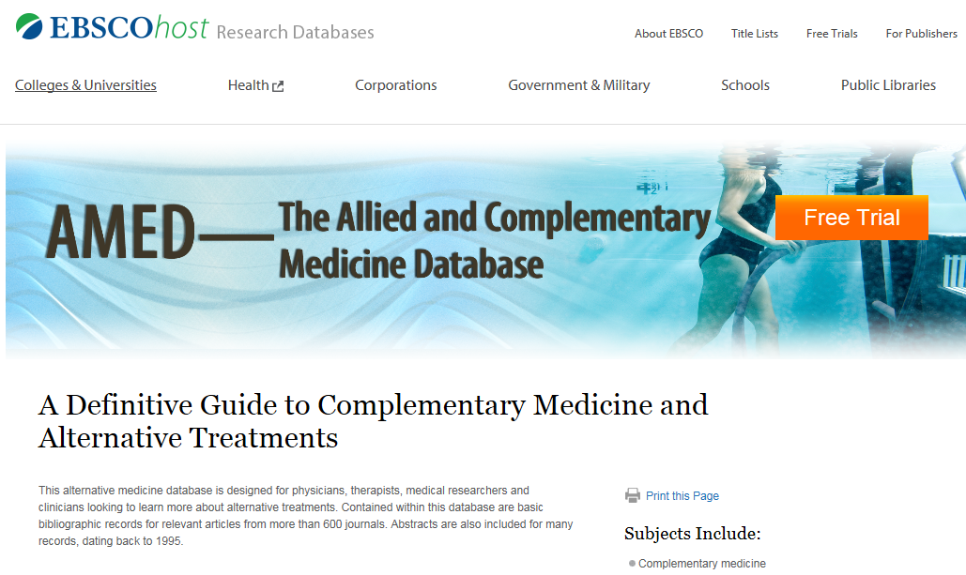
CAM databases
Amed
Compiled by The British Library
Hosted by EBSCOhost and OVID platforms
Literature references / abstracts from more than 600 journals
CAM therapies, palliative care, occupational therapy, physio-therapy, podiatry, rehabilitation
Requires a subscription
Notes:
https://www.ebscohost.com/academic/amed-the-allied-and-complementary-medicine-database
Med Ref Serv Q. 2016 Oct-Dec;35(4):434-439.
AMED: The Allied and Complementary Medicine Database.
Vardell E¹.
Author information:
· ¹a School of Information and Library Science , University of North Carolina at Chapel Hill , Chapel Hill , North Carolina , USA.
Abstract
AMED: The Allied and Complementary Medicine Database is a resource from the Health Care Information Service of the British Library. AMED offers access to complementary and alternative medicine topics, such as acupuncture, chiropractic, herbalism, homeopathy, hospice care, hypnosis, palliative care, physiotherapy, podiatry, and rehabilitation. This column features a sample search to demonstrate the type of information available within AMED. AMED is available through the EBSCOhost and OVID platforms.
PMID: 27657370 [PubMed - as supplied by publisher]

Slide 23
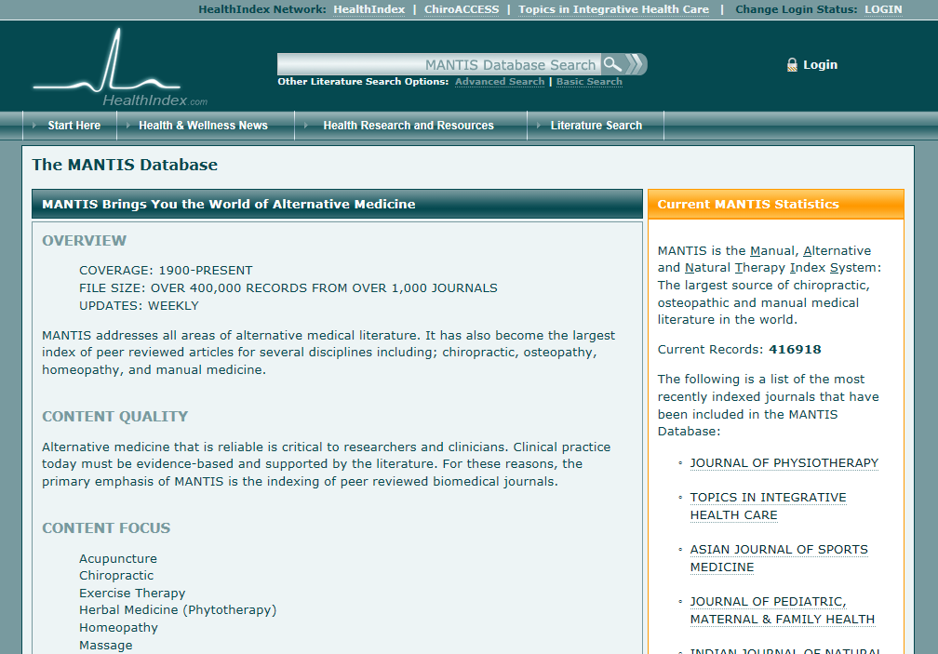
CAM databases
MANTIS
Manual, Alternative and Natural Therapy Index System, by Healthindex
About 420,000 records
Literature references, abstracts
Chiropractice, osteopathy, manual therapy, homeopathy
Requires a subscription
Notes:
http://www.healthindex.com/MANTIS.aspx
Free database, search only via registration.

Slide 24
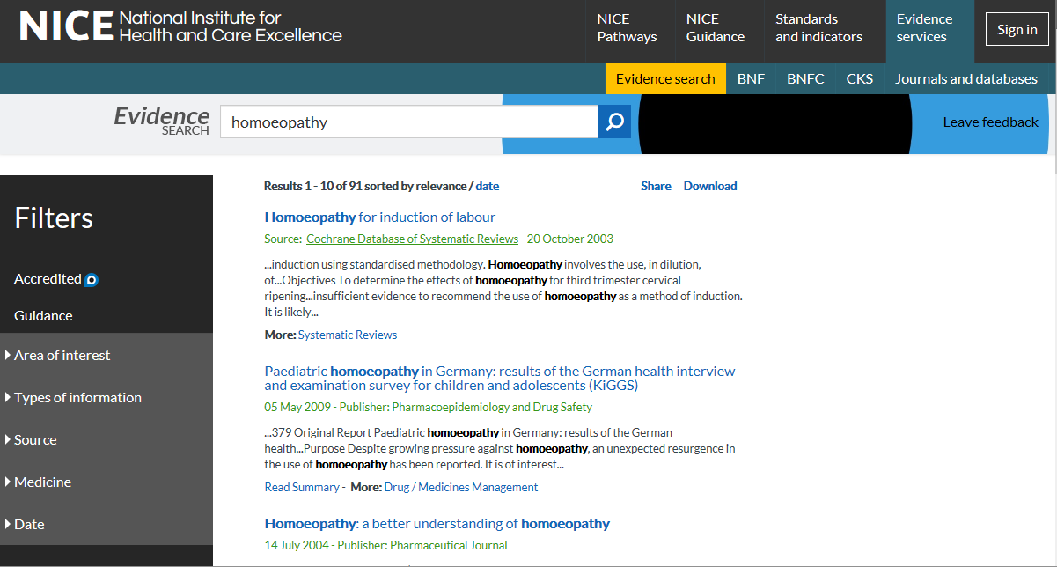
CAM databases
NICE Evidence search
National Insititute for Health and Clinical Excellence
Literature references, patient informations
About 2,200 documents on homeopathy
Notes:
http://www.evidence.nhs.uk/
A search (no registration required) provides a reference list, with links to the publisher of the actual documents.

Slide 25
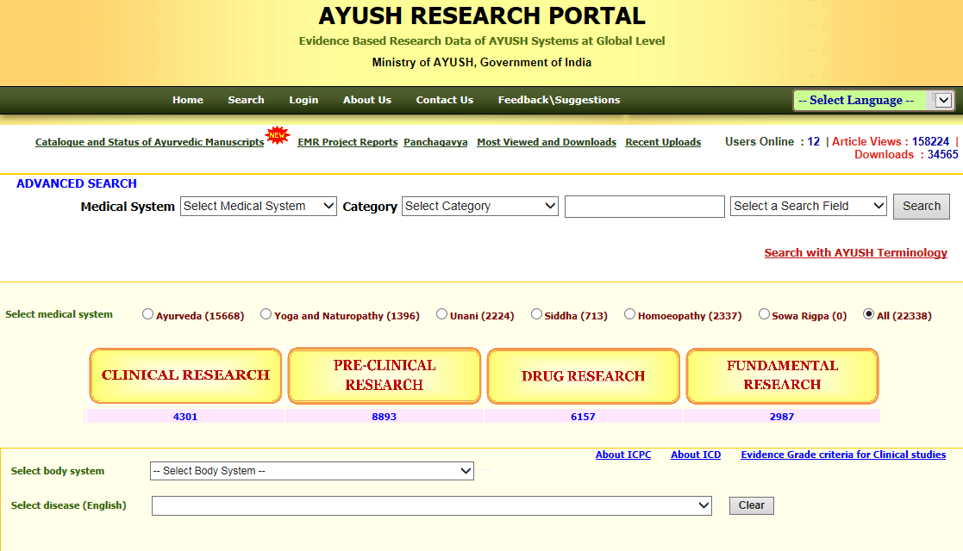
CAM databases
AYUSH Research Portal
Literature references / partially links to full texts
Ministry of Health & Family Welfare, Government of India
About 2,400 references on homeopathy
CAM therapies
Classification in evidence levels according to WHO
Screening of Indian and international journals
Notes:
http://ayushportal.nic.in/
Free database, a search (no registration required) provides a reference list, partially linked to full text.

Slide 26
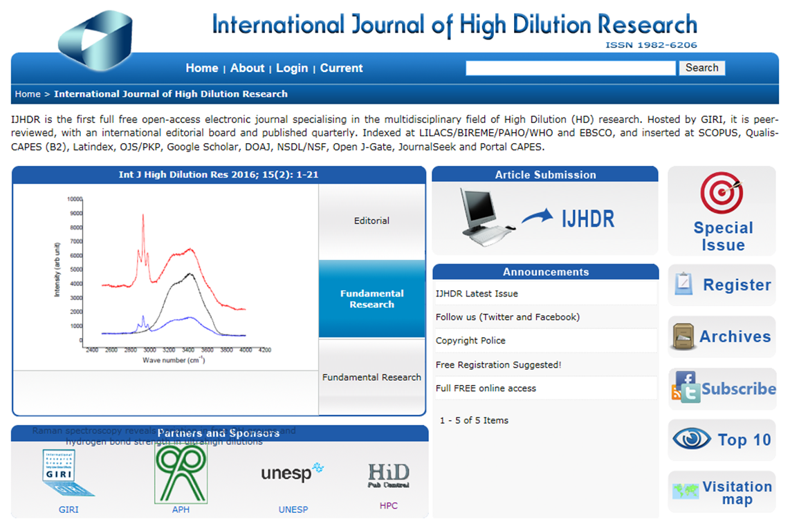
Open Access Journals
International Journal of High Dilution Research
GIRI
High dilution research
Free full text, access without registration
Published quarterly
9 volumes (2008-2016) online
Peer-reviewed
Notes:
http://www.feg.unesp.br/~ojs/index.php/ijhdr/index
Free full text open access journal, access without registration.

Slide 27
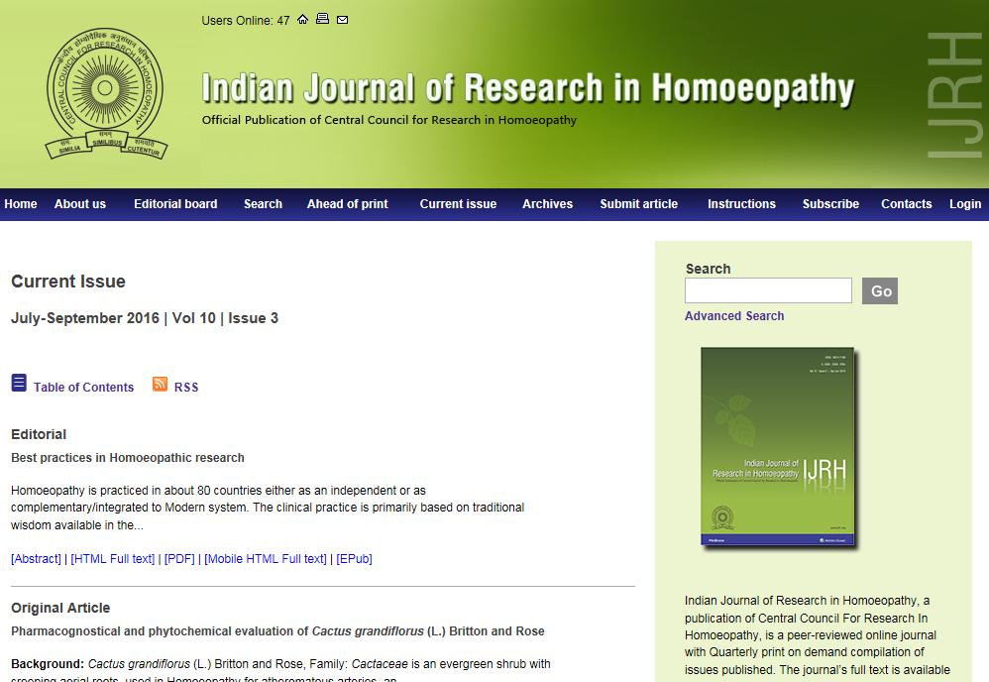
Open Access Journals
Indian Journal of Research in Homoeopathy
Central Council for Research in Homoeopathy
Research in homeopathy
Peer-reviewed
Published monthly
10 volumes (2007-2016),
278 articles online
Free full text,
access without registration
Notes:
http://www.ijrh.org/
Free full text open access journal, access without registration.

Slide 28
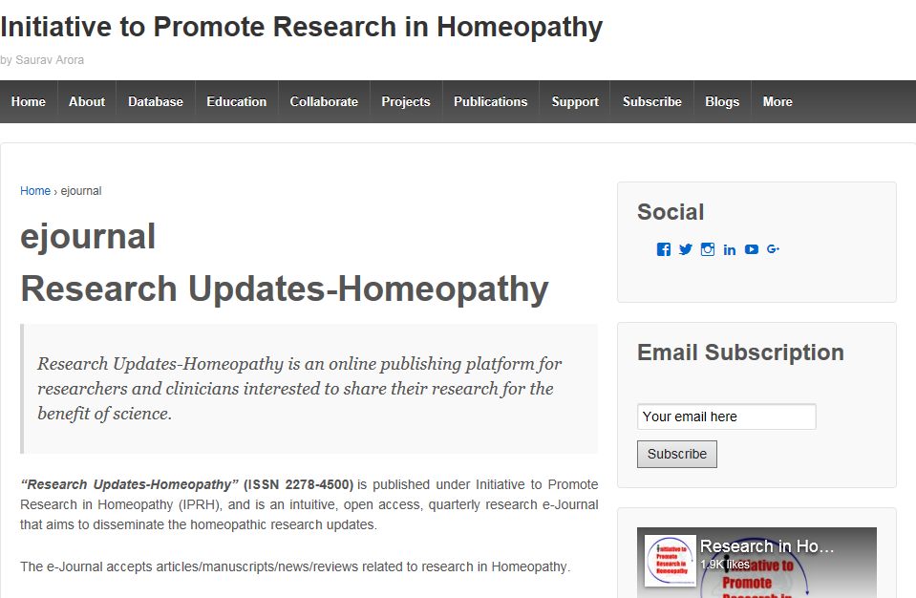
Open Access Journals
Research Updates-Homeopathy
Initiative to Promote Research in Homeopathy (IPRH)
Research in homeopathy
Published quarterly
4 volumes (2013-2016) online
Notes:
http://researchinhomeopathy.org/ejournal/

