Slide 1
Collection and analysis of a large set of clinical cases
Tapakis Lefteris MD
Lilas Theodore PhD

Slide 2

The benefits of case collection

Slide 3
“I am aware of my responsibility and the scientific spirit and I hope that one day my work will also have the honour to be read so seriously and scrutinized in the same spirit. In words of our medical prophet ‘my vanity does not go far’.”
The Organon of the Healing Art. Prologue

Slide 4
“… In the 21st century we saw however a revival of interest in clinical case reports. This development was also spurred on by a deeper understanding of the full meaning of ‘Evidence Based Medicine’: this involves practicing medicine not just based on the best available research evidence, but rather on the integration of evidence with clinical expertise and patient values..”
Robbert van Haselen, Complement Ther Med. Harvesting the benefits of clinical case reports: How to separate the chaff from the wheat? 2015 Apr;23(2):139-40

Slide 5


The benefits of case collection
Provide useful evidence regarding the effectiveness of homeopathic treatment
Improve the repertory and materia medica from clinical experience
Improve daily homeopathic practice by sharing experience.

Slide 6
Provide useful evidence regarding the effectiveness of homeopathic treatment
To make our work known

Slide 7
While homeopathy is spreading, and is the second most popular therapeutic modality (WHO), it does not have the proper number and the quality of scientific announcements.

Slide 8
“…the successes of homeopathy have remained hidden in the offices of hardworking homeopaths - and thus go largely ignored by the world’s medical authorities, governments, and the whole international scientific community.”
George Vithoulkas, J Med Life.
An innovative proposal for scientific alternative medical journals. 2017 Jul-Sep; 10(3): 197–199

Slide 9
To improve repertory and materia medica

Slide 10
To improve homeopathy by giving answers to questions deriving in daily practice:
“Why, for instance, in a case of rheumatoid arthritis, one patient is cured with one or two remedies in a period of a few months, while another needs four or more remedies in a period of several years, even with careful prescribing? What are the parameters that define one or the other response?”
“Why, in one case, is the daily repetition of a high potency a false tactic with a negative outcome, while in another case, it is necessary and associated with positive results? “
“Why do low potencies act better in one case, while high potencies are best for another patient, even when they have the same pathology?”
“Why, in certain cases, do we have a strong initial aggravation, while in others, the effect goes smoothly and without aggravation?”
George Vithoulkas, J Med Life. 2017 Jul-Sep; 10(3): 197–199

Slide 11
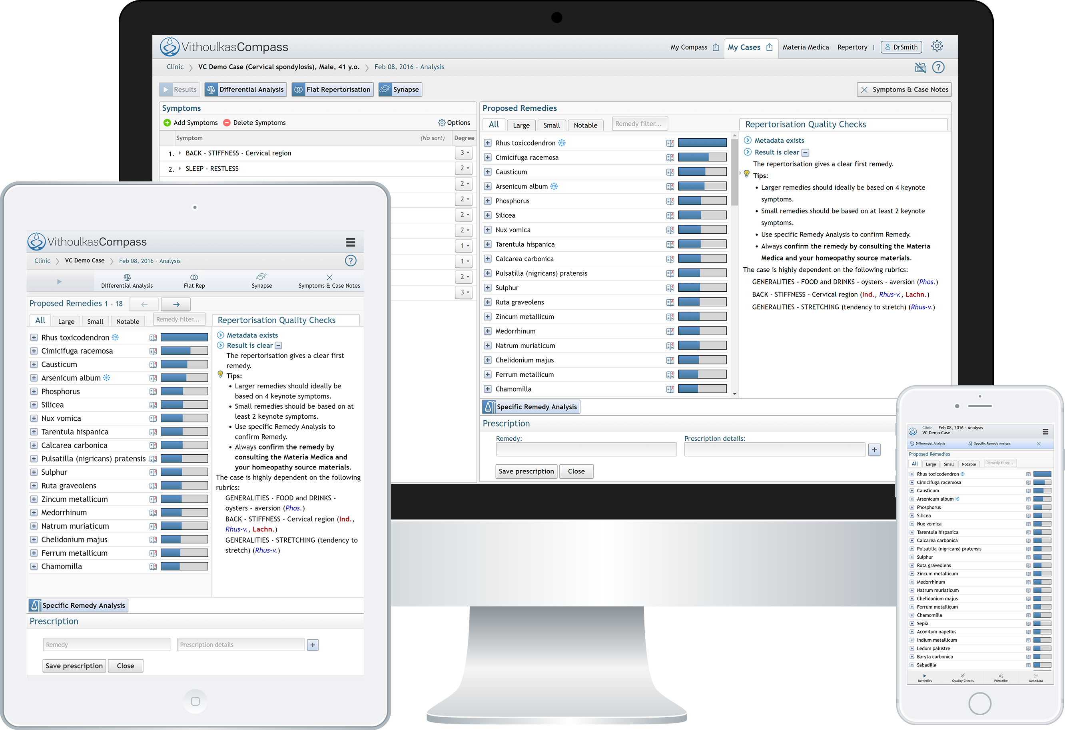

Online platform to collect cases

Slide 12
Announcements
Liga 2011
New Delhi
HRI 2013
Barcelona
HRI 2015
Rome
ECH 2016
Vienna
The case of VithoulkasCompass, the latest classical homeopathy online expert system
Assessment of a new decision support system in headache cases
Statistical analysis of 156 cases of depression treated with classical homeopathy
Rubrics verification and repertory improvement through statistical feedback from real cases

Slide 13
Announcements
ECH 2016
Vienna
HRI 2017
Malta
Liga 2017
Leipzig
Liga 2017
Leipzig
Prescription success rate among various remedies: Where is our weak spot
Analysis of 191 cases with panic attacks
Large Repertory additions- much of them do we really need and use?
Liga Todd Hoover and Robbert van Haselen announced a retrospective study about the use of the symptoms of provings with data from VithoulkasCompass

Slide 14





Interesting information about a set of cases
Gender
Geographical distribution
Prescribed remedies
Success rate.

Slide 15


HRI Rome 2015
Statistical analysis of cases with depression.

Slide 16
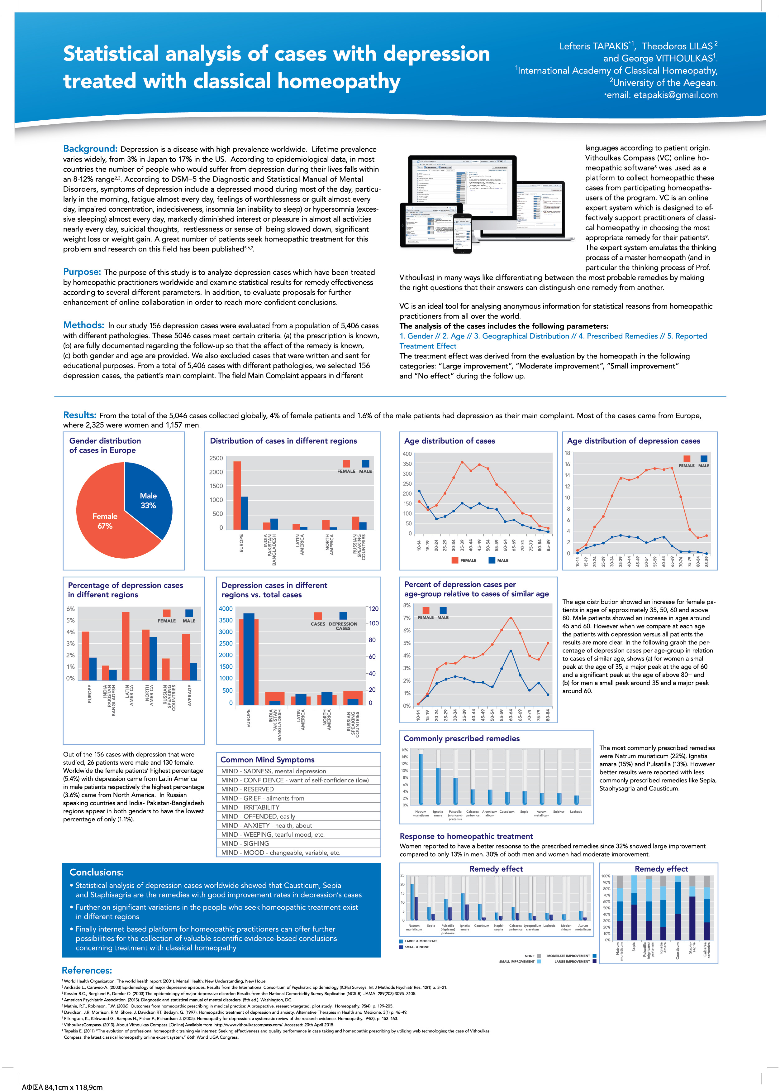

Slide 17
Statistical analysis of cases with depression
HRI 2015 Rome

Slide 18
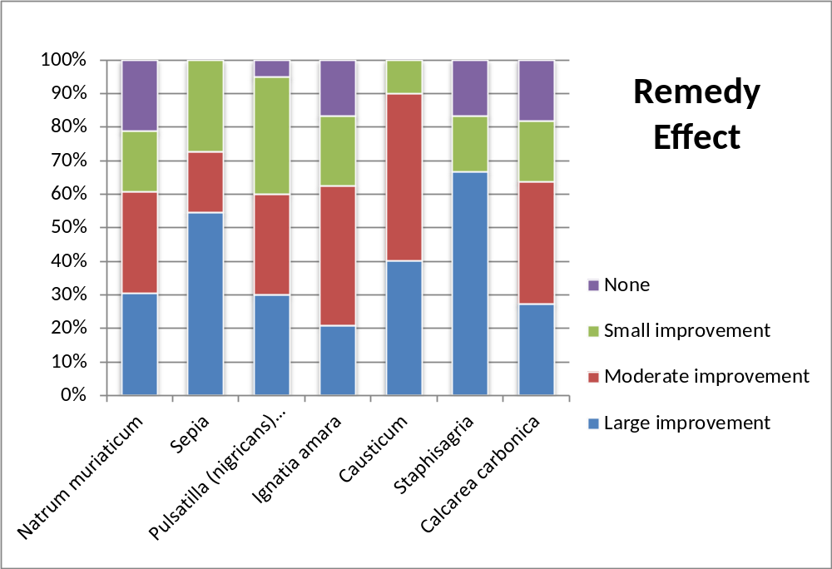
Remedy effect

Slide 19
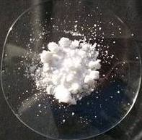
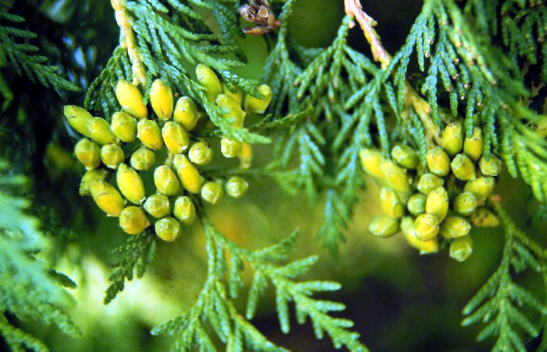
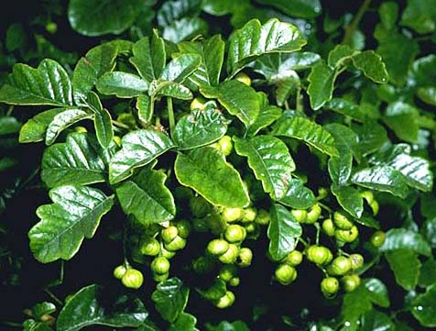
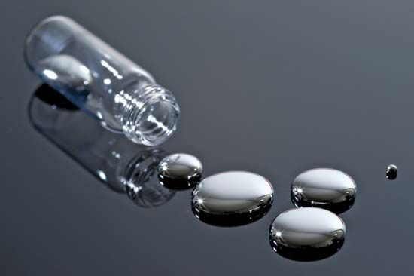
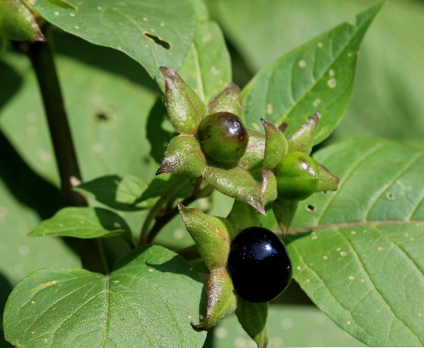
ECH European Congress Vienna 2016
Various remedies success rate - Where is our weak spot?
Kali Carbonicum
Thuja
Rhus Tox
Belladonna
Mercurius Solubilis

Slide 20
ECH European Congress Vienna 2016
Various remedies success rate - Where is our weak spot?
Why the above remedies have lower success rate than others?
Traits of personality instead of real symptoms of the pathology?
Is their representation in the repertory correct?
We evaluate the reliability of the symptoms on which the prescriptions have been based on and especially of these remedies with the lowest success rates.

Slide 21
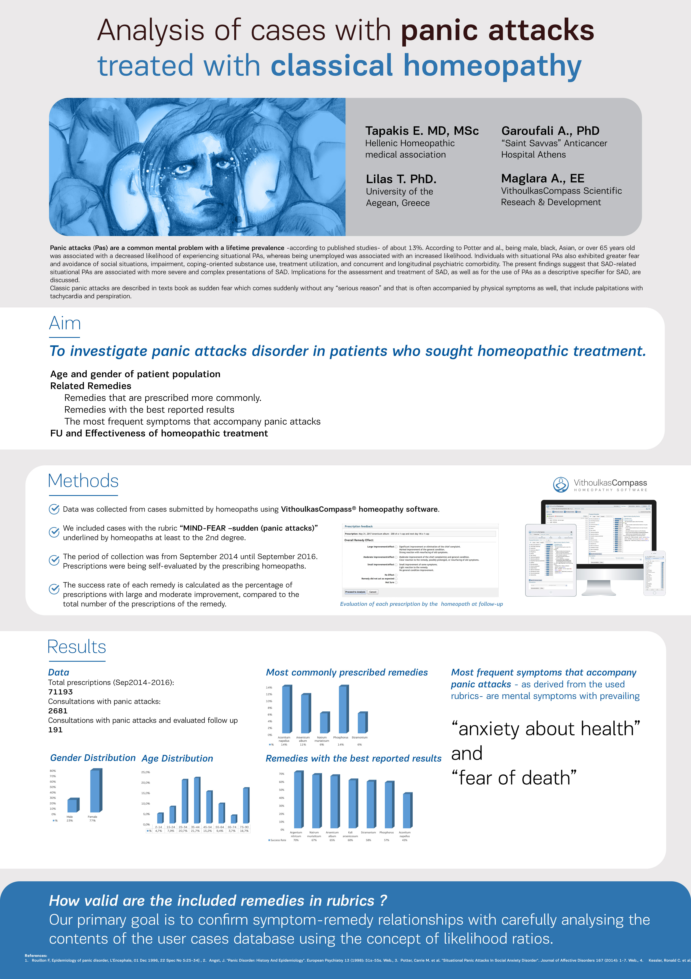
HRI Malta 2017
Analysis of cases with panic attacks

Slide 23
Analysis of cases with panic attacks treated with classical homeopathy
HRI 2017 Malta
Notes:
The most commonly prescribed remedies were Acon, Ars, Nat-m, Phos and Stram

Slide 24
Analysis of cases with panic attacks treated with classical homeopathy
HRI 2017 Malta

Slide 25
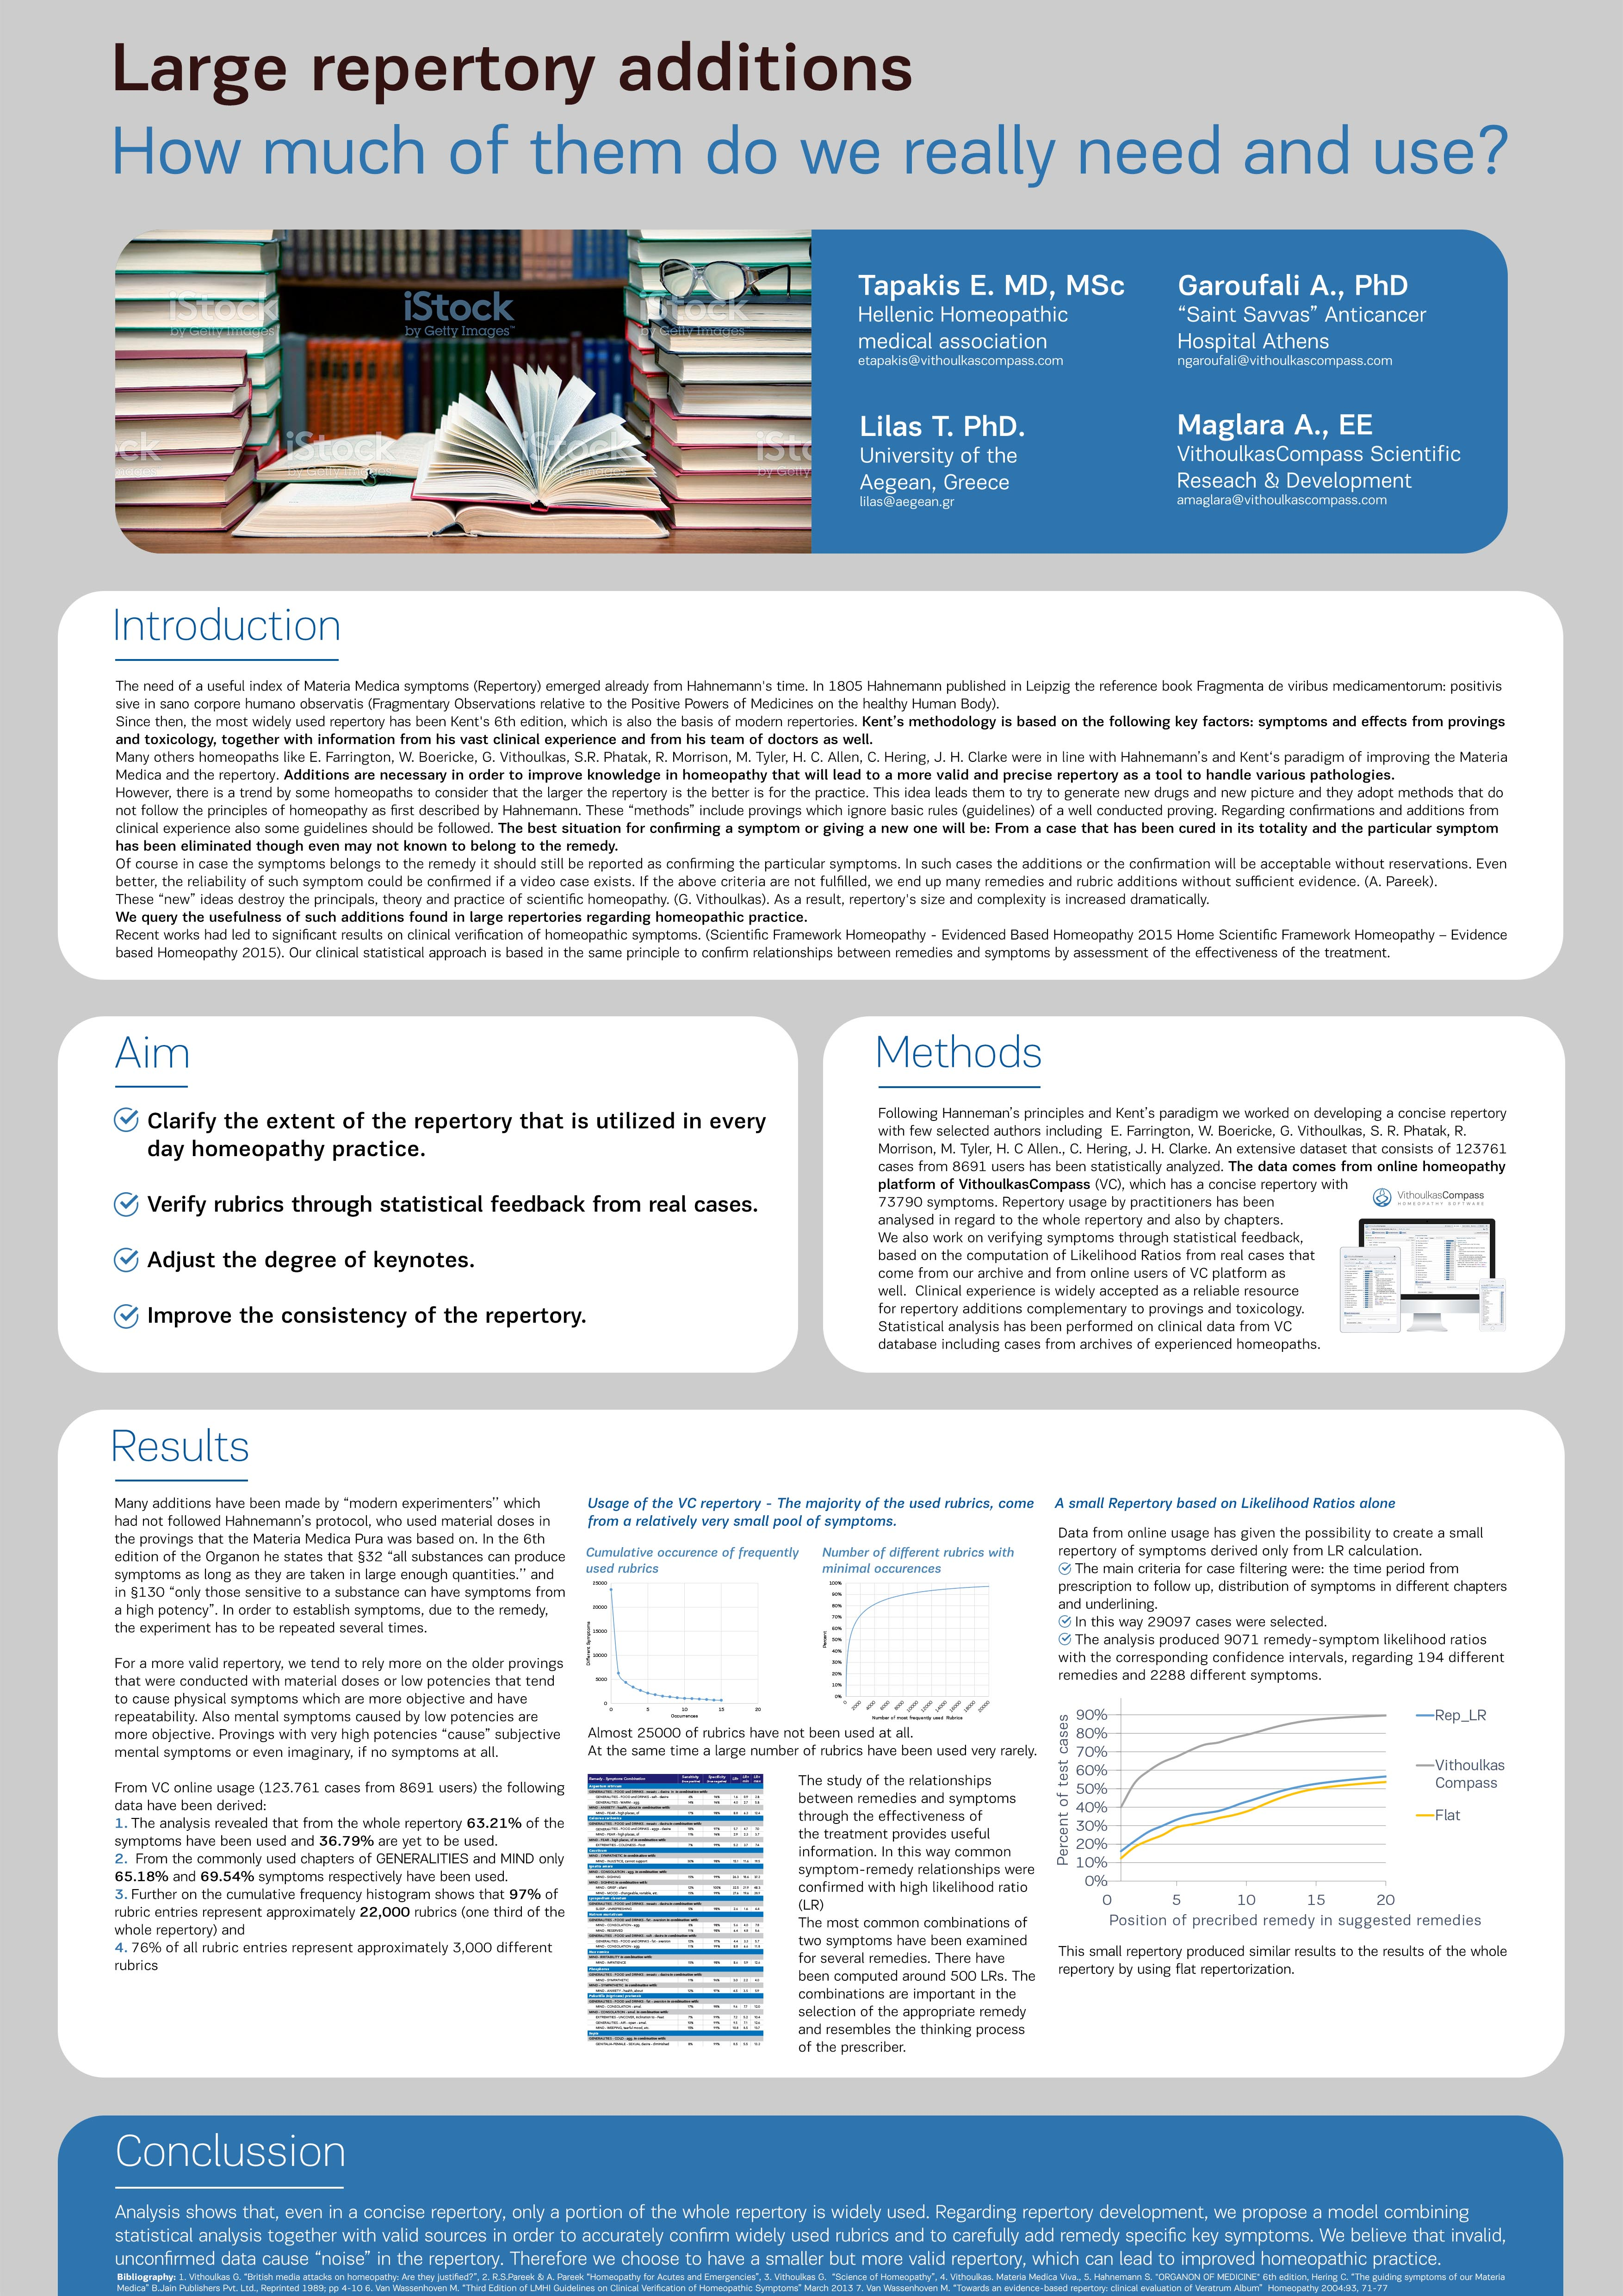
Liga, Leipzig 2017.
Large repertory additions. How much do we really need and use?

Slide 26
Liga, Leipzig 2017.
Large repertory additions. How much do we really need and use?

Slide 27
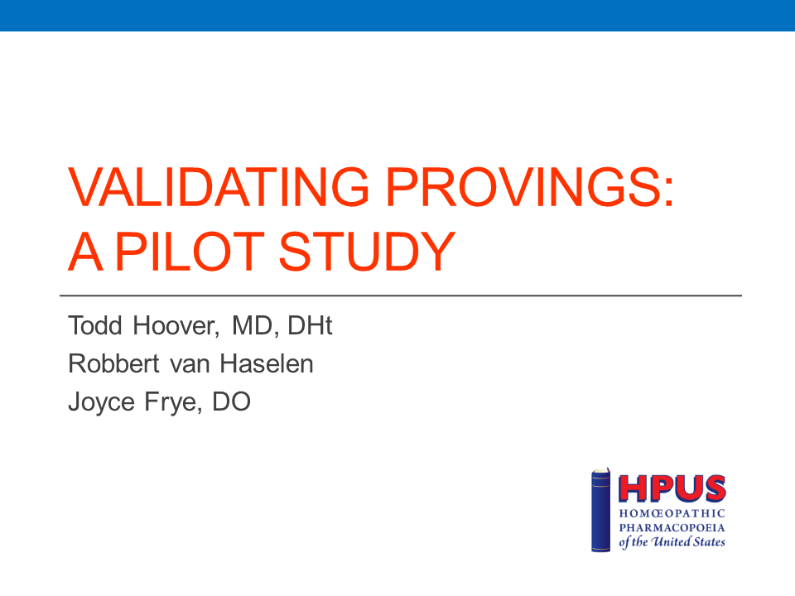
Validating the clinical predictive value of homeopathic provings – a pilot study comparing retrospectively collected proving and clinical data
Liga, Leipzig 2017.

Slide 28
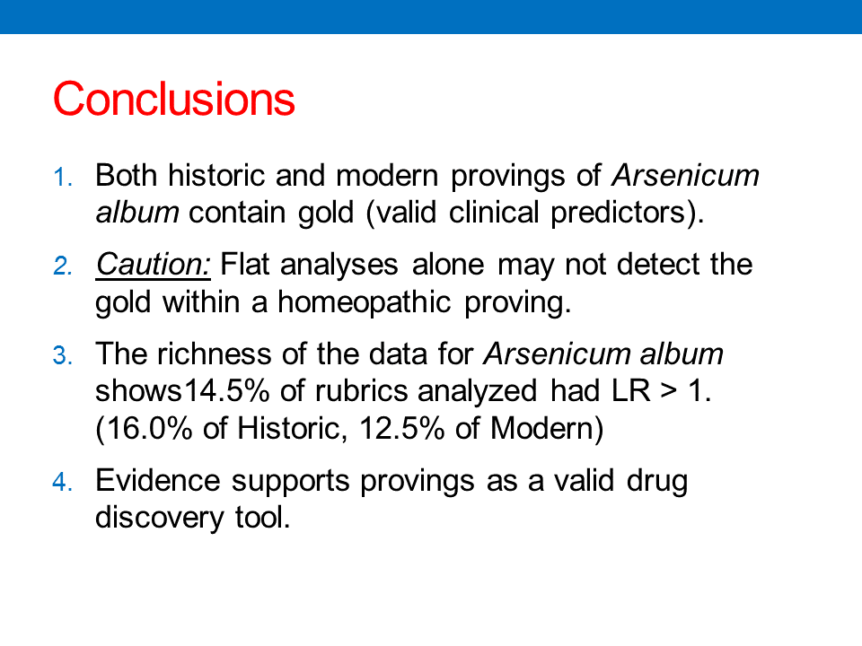
Validating the clinical predictive value of homeopathic provings – a pilot study comparing retrospectively collected proving and clinical data
Liga, Leipzig 2017.

Slide 29
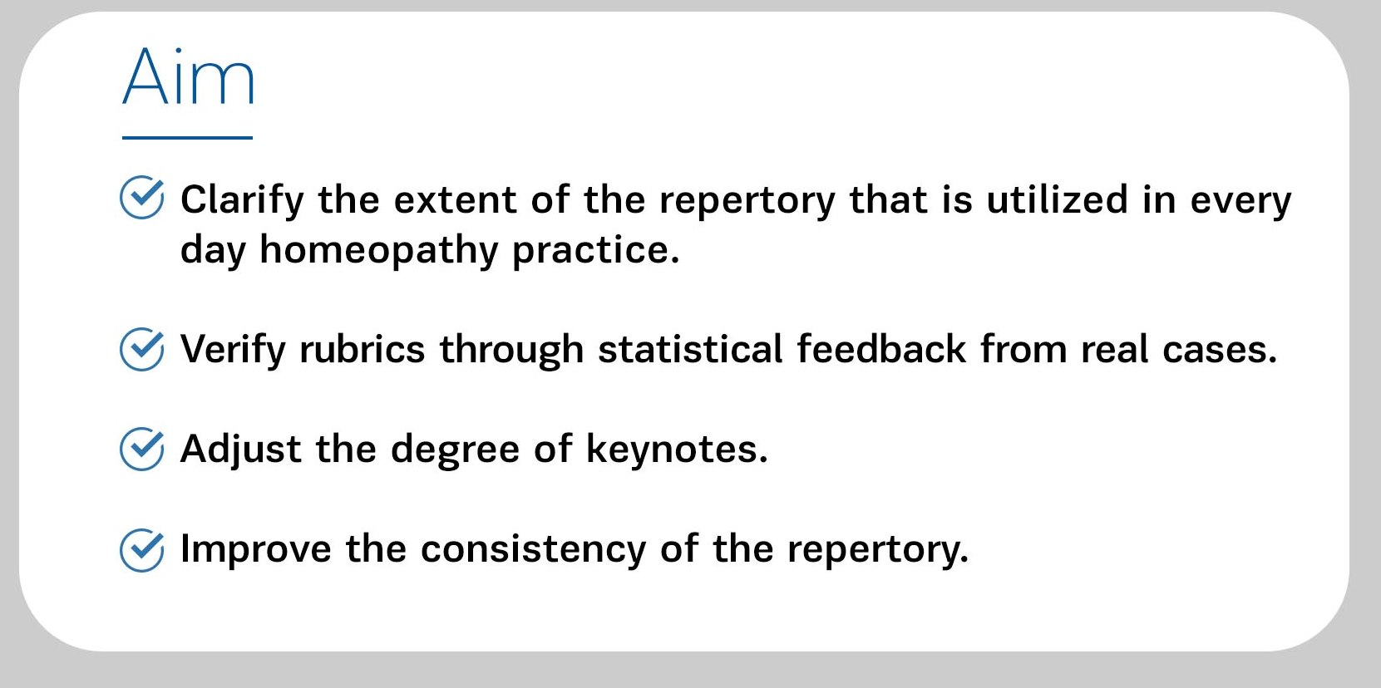
Statistical feedback from real cases

Slide 30

Repertory utilization
The study analyzed statistically 123.761 cases from 8691 users from the VC database including repertorized archived cases from established homeopaths. In reference to the utilization of symptoms, the following indicators were derived:
The analysis revealed that from the whole repertory 63.21% of the symptoms have been used and 36.79% are yet to be used.
From the commonly used chapters of GENERALITIES and MIND only 65.18% and 69.54% symptoms respectively have been used.
Further on the cumulative frequency histogram shows that 97% of rubric entries represent approximately 22,000 rubrics (one third of the whole repertory) and
76% of all rubric entries represent approximately 3,000 different rubrics

Slide 31
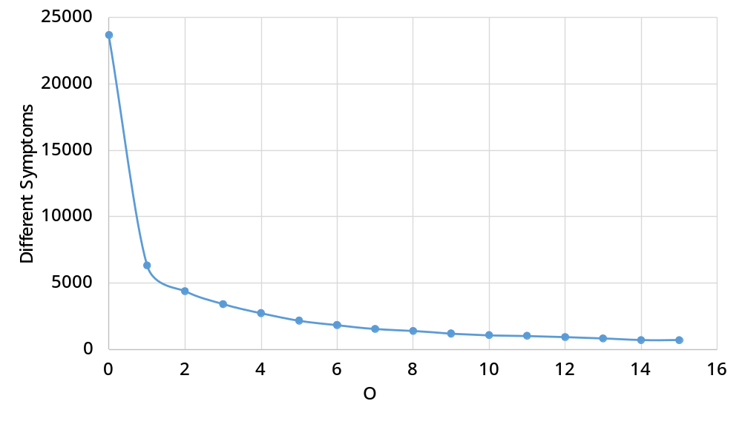
Repertory utilization
Number of different rubrics with minimal occurrences
Almost 25000 out of 75000 rubrics have not been used at all.
A large number of rubrics have been used very rarely.

Slide 32
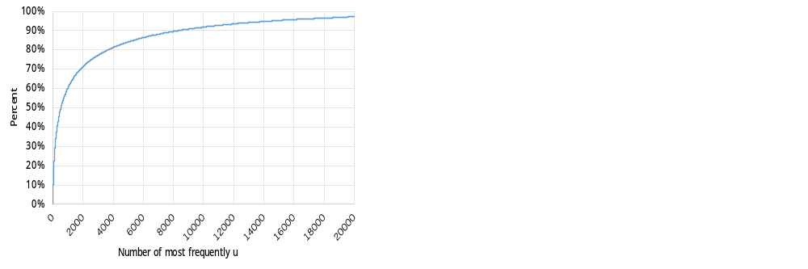
Repertory utilization
Cumulative occurrence of frequently used rubrics

Slide 33
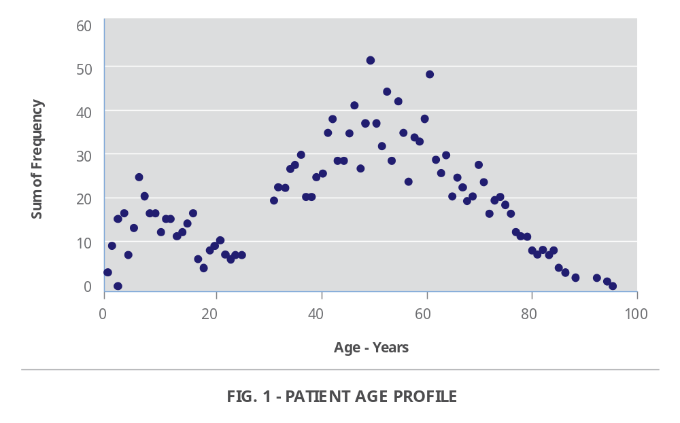
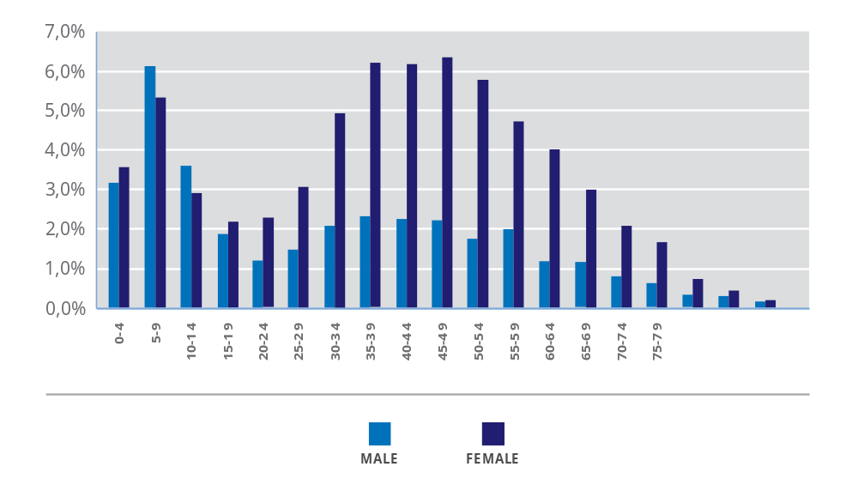
Age distribution of patients
“Towards standard setting for patient-reported outcomes in the NHS homeopathic hospitals”, Elizabeth A. Thompson et. Al., Homeopathy (2008) Vol. 97, p. 114–121
- 1797 patients: peak at 49 and 6 years old
- Similar distribution curve on 20000 patients: peak at 45 and 10 years old

Slide 34



Improving the repertory and materia medica from clinical experience
Clinical experience is a predominant resource for repertory additions complementary to toxicology and provings. However, repertory authors evaluate remedy grades in different ways so repertories are generally not fully coherent.
Therefore a clear methodology for clinical data collection and statistical evaluation is required, which respects the ‘essence’ of homeopathic practice, the law of similars and the individualization rule.
The approach is based on the computation of Likelihood Ratios similar to the extensive work described in the Clinical verification of homeopathic symptoms, in SCIENTIFIC FRAMEWORK OF HOMEOPATHY, Revised edition after 69th LMHI Congress

Slide 35
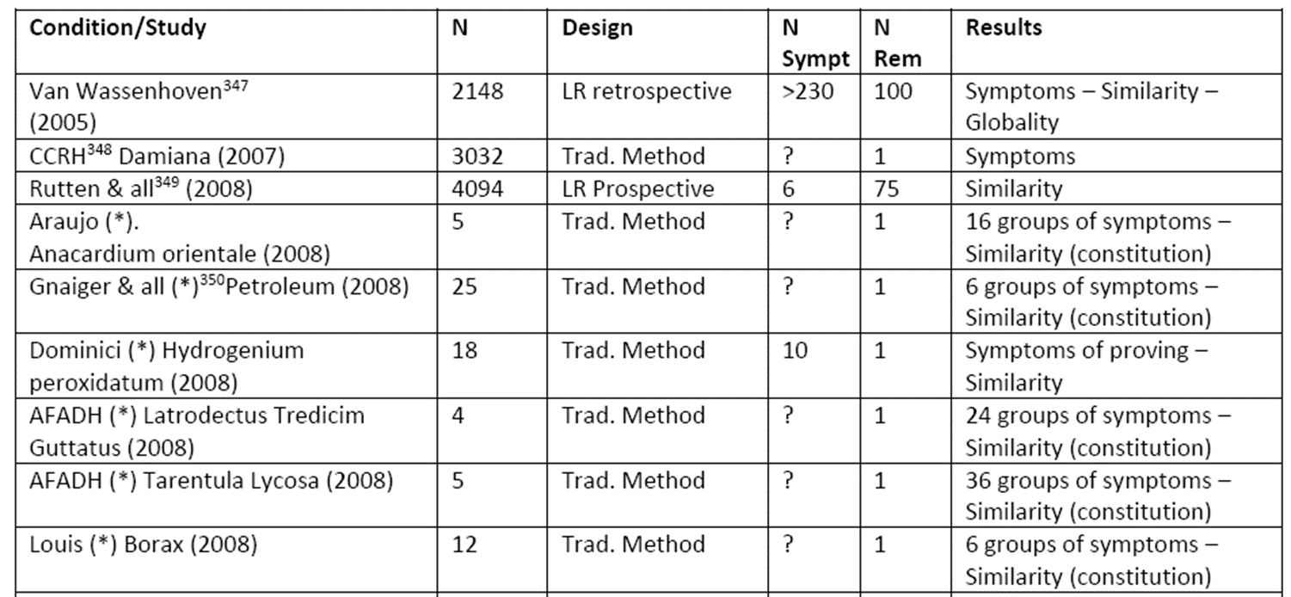
Clinical verification of homeopathic symptoms
SCIENTIFIC FRAMEWORK OF HOMEOPATHY, Evidence Based Homeopathy, Revised edition after 69th LMHI Congress, July 2014 (Paris, France), Dr. Raj K. Manchanda, 2015

Slide 36


Aim of Statistical Analysis
The aim is to verify rubrics through statistical analysis of numerous real cases in order to improve the consistency of the repertory and provide quality criteria for additions to the repertory.
The approach is based on the Quality Improvement Paradigm whose main points are: setting of clear targets, selection of suitable approach, development of solutions, statistical analysis of results and feedback utilization for continuous improvement.
Statistical analysis was performed on clinical data from the VithoulkasCompass database including cases from archives of experienced homeopaths.

Slide 37
The Naranjo adverse drug reaction probability scale
 | Yes | No | Do not know
1. Are there previous conclusive reports on this reaction? | +1 | 0 | 0
2. Did the adverse event occur after the suspected drug was administered? | +2 | -1 | 0
3. Did the adverse reaction improve when the drug was discontinued or a specific antagonist was administered? | +1 | 0 | 0
4. Did the adverse reaction reappear when the drug was readministered? | +2 | -1 | 0
5. Are there alternative causes (other than the drug) that could have on their own caused the reaction? | -1 | +2 | 0
6. Did the reaction reappear when a placebo was given? | -1 | +1 | 0
7. Was the blood detected in the blood (or other fluids) in concentrations known to be toxic? | +1 | 0 | 0
8. Was the reaction more severe when the dose was increased or less severe when the dose was decreased? | +1 | 0 | 0
9. Did the patient have a similar reaction to the same or similar drugs in any previous exposure? | +1 | 0 | 0
10. Was the adverse event confirmed by any objective evidence? | +1 | 0 | 0

Slide 38
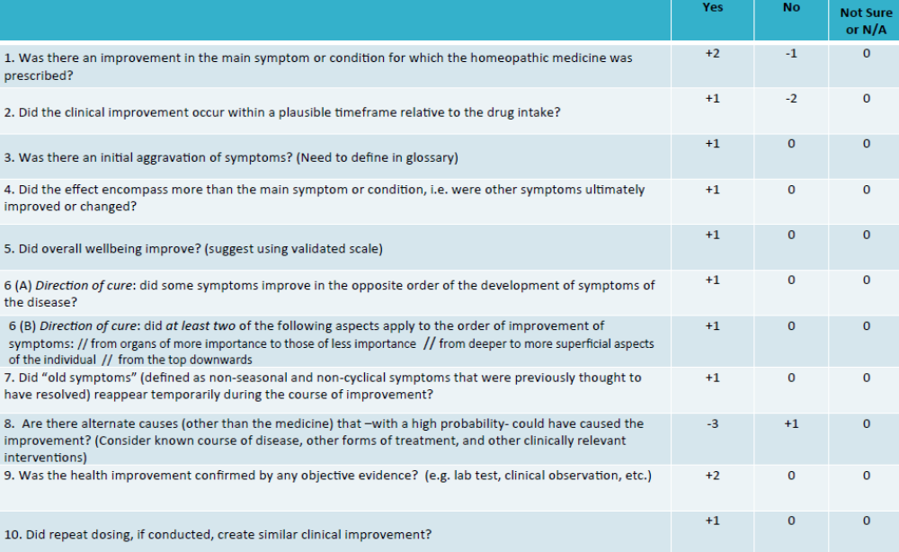
Modified Naranjo Criteria for homeopathy follow-up

Slide 39
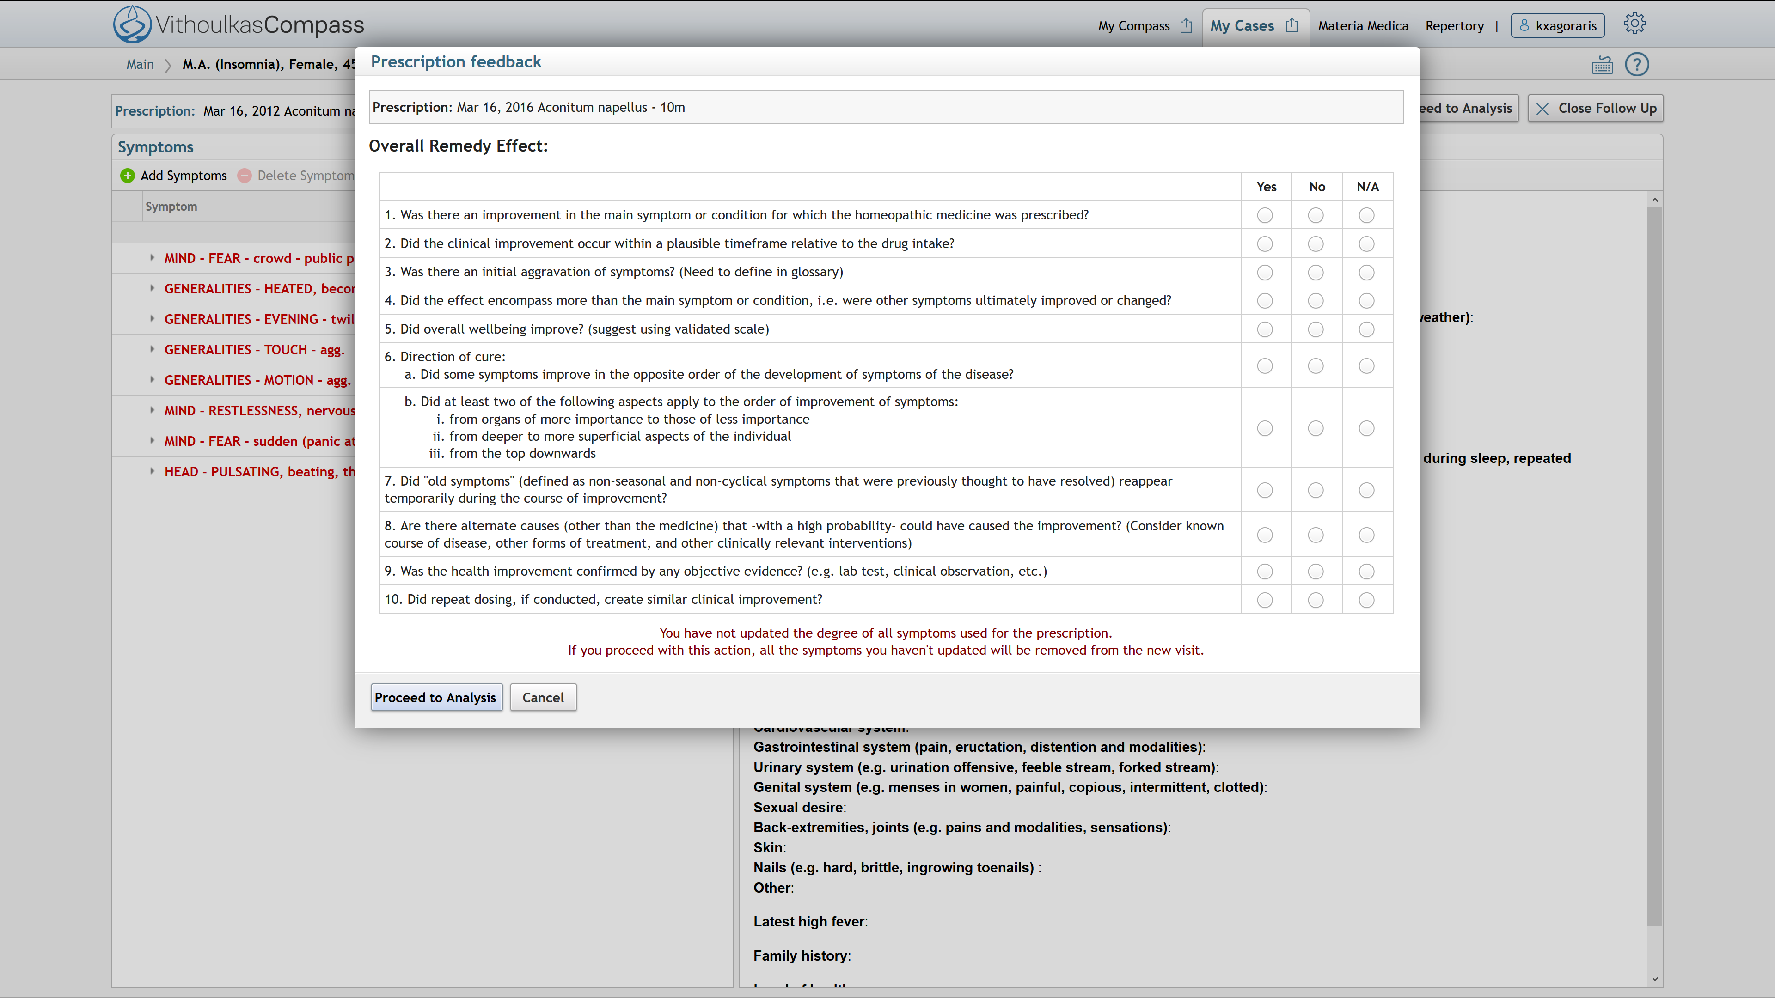
Follow-up Questionnaire – Researcher mode

Slide 40
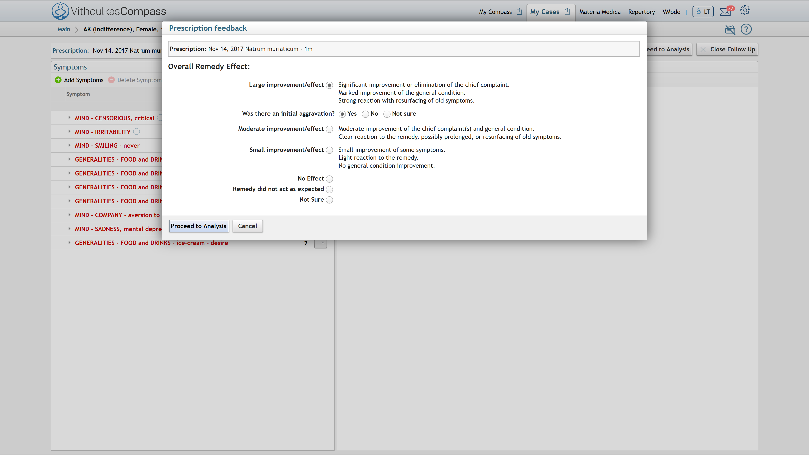
Follow-up Questionnaire

Slide 41
Likelihood ratio in clinical trials
 | Remedy Worked Large Improvement | Remainder of cases
Symptom present | True positive (TP) (symptom present and remedy worked) | False positive (FP) (symptom present in remainder of cases) | Positive predictive value = TP / (TP + FP)
Symptom not present | False negative (FN) (symptom not present and remedy worked) | True negative (TN) (symptom not present in remainder of cases) | Negative predictive value = TN / (FN + TN)
 | Sensitivity = TP / (TP + FN) | Specificity = TN / (FP + TN)

Slide 42
Likelihood ratio confidence interval
$$\text{LR}\text{+}\text{ = }\frac{\text{sensitivity}}{\text{1−}\text{specificity}}$$
is the percentage (prevalence) of a symptom in the population that was improved by a certain remedy
divided by the percentage of the same symptom in the remainder of the whole treated population
$sensitivity= \frac{TP}{TP+FN} , specificity=\frac{TN}{FP+TN}$
${LR}_{min }= e^{\ln\left(LR\right)−Z_{\frac{a}{2}}×{SE}_{LR}} ,$
${LR}_{max }= e^{\ln\left(LR\right)+Z_{\frac{a}{2}}×{SE}_{LR}},$
The smaller the absolute difference the better: abs(${LR}_{max }−{LR}_{min })$
$$where {SE}_{LR }=\sqrt{\frac{1}{TP}−\frac{1}{TP+FN}+\frac{1}{FP}−\frac{1}{FP+TN}} \\ Z_{\frac{a}{2}} : confidence coefficient=1.96 for α=95\%, confidence level$$

Slide 43
Remedy-Symptom LR computations
Remedy - Symptom Combination | Sensitivity | LR | LR min | LR max
Arsenicum album
MIND - FASTIDIOUS | 34.1% | 6.9 | 5.4 | 8.9
STOMACH - THIRST - small quantities, for (in sips) - often | 22.5% | 16.2 | 11.4 | 23.1
Causticum
MIND - INJUSTICE, cannot support | 60.3% | 14.6 | 11.9 | 17.9
MIND - SYMPATHETIC | 37.0% | 3.6 | 2.6 | 4.9
Ignatia amara
MIND - GRIEF - silent | 21.5% | 14.3 | 9.7 | 21.1

Slide 44
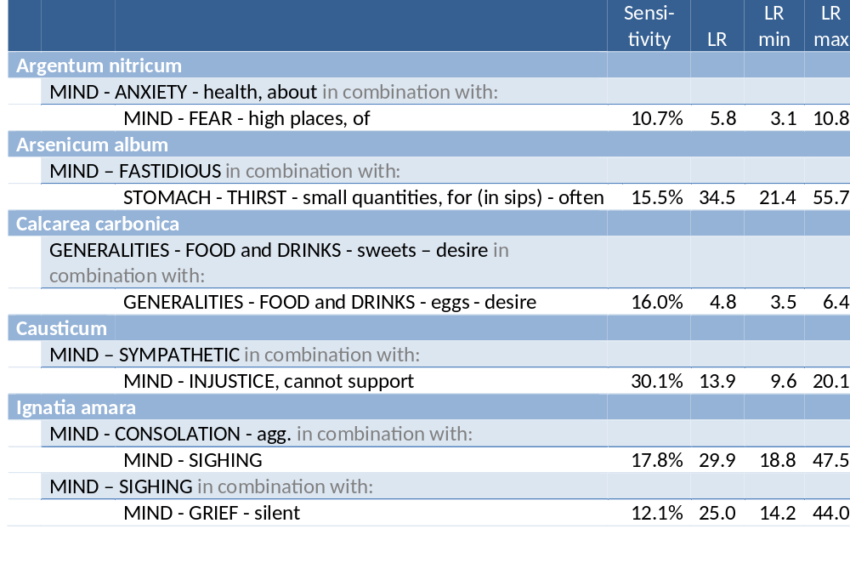
Combinations of symptoms
The most common combinations of two symptoms have been examined for several remedies. There have been computed around 500 LRs. The combinations are important in the selection of the appropriate remedy and resembles the thinking process of the prescriber.

Slide 45
A small Repertory based on Likelihood Ratios alone
Data from online usage has given the possibility to create a small repertory of symptoms derived only from LR calculation.
The main criteria for case filtering were: the time period from prescription to follow up, distribution of symptoms in different chapters and underlining.
In this way 29097 cases were selected.
The analysis produced 9071 remedy-symptom likelihood ratios with the corresponding confidence intervals, regarding 194 different remedies and 2288 different symptoms.
This small repertory produced similar results to the results of the whole repertory when using simple flat repertorization algorithms.

Slide 46
Feedback and continuous improvement
Small repertory based on LR computations:
194 different remedies
2288 different symptoms
9071 remedy-symptom pairs
Similar effectiveness compared to whole repertory with flat remedy selection from
Potential to improve VC by combining repertories.

Slide 47
Supporting tools for homeopathic practice
Targets: high quality and high accuracy, robust and useful software
Methodology: Quality improvement paradigm
A goal-driven feedback-oriented improvement paradigm for software engineering based on total quality principles, and on the plan/do/check/act management cycle
Statistical analysis
Feedback and Continuous improvement: Users provide useful information for improving both algorithms and the repertory. For example if a remedy cures a symptom many times this is a confirmation for an existing rubric or a case study for a new relation between the remedy and the symptom

Slide 48
Conclusions derived from statistical analysis
Analysis shows that, even in a concise repertory, only a portion of the whole repertory is widely used.
The study of the relationships between remedies and symptoms through the effectiveness of the treatment provides useful information. In this way common symptom-remedy relationships were confirmed with high likelihood ratios (LR).
Combining statistical analysis together with valid sources adjustments were made in the degrees of keynotes and the mostly used symptoms.
Evidence based models can be consistently applied to homeopathic cases.
Collaborative development of a confirmed and coherent repertory can lead to improved homeopathic practice.

Slide 49
Encouraging initial results from analysis of cases
Provide useful evidence regarding the effectiveness of homeopathic treatment
Improve the repertory and materia medica from clinical experience
Improve daily homeopathic practice by sharing experience.

Slide 50
Thank you for your attention

