Slide 1
Clinical trial regulation :highlights
Consultative Committee ,27 th September 2012
Greet Musch & Kristof Bonnarens

Slide 2
Overview
Authorisation procedure
Risk-adaptation
Other changes
Impact on the current working groups

Slide 3
Autorisation procedure : submission (1)
« Flexible geometry » : process only defined until memberstate level – roles EC / NCA not defined
All submissions through one single IT portal
No difference between :
  multinational / mononational trials
  commercial / non-commercial trials
One submission dossier for the EU, requirements described in the annexes of the regulation (CT-1 + CT-2)

Slide 4
Autorisation procedure : submission (2)
Sponsor choses reporting memberstate (must be concerned)
Other concerned memberstates can take over if mutually agreed
Assessment of two parts :
Part I by reporting memberstate
(with input from other memberstates)
Part II by all memberstate

Slide 5
Autorisation procedure : assessment (1)
Part I = « harmonised advice » by reporting MS

Slide 6
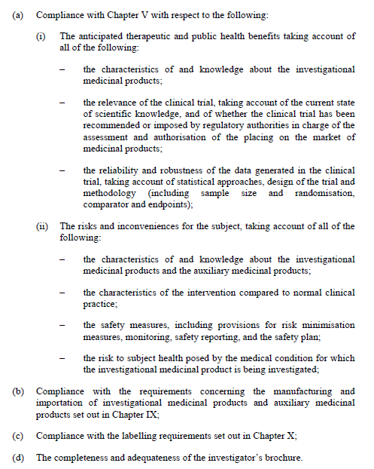

Slide 7
Autorisation procedure : assessment (3)
Part II = « national advice » by each concerned MS

Slide 8
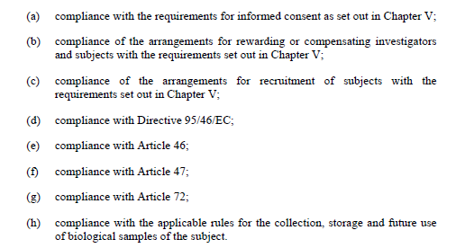
Notes:
46 : suitability of investigators
47 : suitability of trial sites
72 : damage compensation

Slide 9
Autorisation procedure : assessment (5)
Timeframe for assessment :
6 days for validation by proposed MS
25 days for part I assessment (10 – 30)
10 days for part II assessment
10 days for final decision
Clockstops in both validation and assessment phase possible !

Slide 10
Autorisation procedure : decision
One single decision, principle of tacit approval
Involvement of laymen and patiens obligatory
Opting out possible (but limited)
Adding of memberstates – reporting MS remains
Substantial amendments – reporting MS remains
Disconnect between part I and part II possible

Slide 11
Risk-adaption (1)
Principle of « low-intervention trials »
  → Adaption of timelines (shorter) and damage compensation
Safety reporting :
  normal pharmacovig for low-intervention trials
  Expedited reporting / DSUR reporting remains cfr. CT3
  all safety reporting via EudraVigilance-CTM

Slide 12
Risk-adaption (2)
Same rules for IMPs and Auxiliary MP’s (ex-NIMP) for manufacturing and labelling
Autorisation for manufacturing required, but exceptions remain
Magistral / officinal preparations can be used
Authorised products in open label trials : easier labelling

Slide 13
Other changes (1)
Changes in scope / terminology :
Research with medicinal products
CLINICAL STUDIES
Interventional studies
« Clinical trials »
Non-interventional
studies
Low-intervention
clinical trials

Slide 14
Other changes (2)
Insurance mechanism to be set up by MS
Cosponsorship possible
Contact person within the EU obligatory
CTFG → CTAG (presidency & secretariat by Commision)
Implementation : 2 years after publication

Slide 15
Impact on the current working groups (1)
Template for the motivation of an advice (UZ Gent)
Quality system + conflicts of interest + Competences in the recognised ethics committees (UA / Hôpital Erasme)
Meetings with the recognised ethics committees (UZ Leuven /Hôpital Erasme)
Elaboration of the recognition process (FAMHP)
Installment and use interactive website (FAMHP)
Description of the respective roles and responsibilities of EC's and FAMHP (FAMHP)

Slide 16
Impact on the current working groups (2)
Template for the motivation of an advice (UZ Gent)
Quality system + conflicts of interest + Competences in the recognised ethics committees (UA / Hôpital Erasme)
Meetings with the recognised ethics committees (UZ Leuven /Hôpital Erasme)
Elaboration of the recognition process (FAMHP)
Installment and use interactive website (FAMHP)
Description of the respective roles and responsibilities of EC's and FAMHP (FAMHP)

Slide 17
Contact
Federal agency for medicines and health products - famhp
Place Victor Horta 40/40
1060 Bruxelles
tel. 0032 2 524 80 00
fax 0032 2 524 80 01
e-mail welcome@fagg-afmps.be
www.afmps.be

